Slide 1
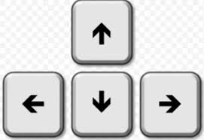
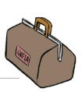



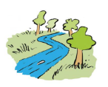



Look at the pictures and repeat the words you hear. Gledaj slike i ponovi riječi koje čuješ.
KLIKNI OVU STRELICU NA TIPKOVNICI KAKO BI SE ČUO ZVUK I KAKO BI SE SLIKE POMJERALE.
a vet’s bag
a basket
a camera
binoculars
a bush
a thorn
a river

Slide 2
What’s in the picture? Point to the picture and name it.
Što je na slici? Pokaži na sliku i reci što je na slici.

Slide 3
Play the games and learn all the words. Odigraj igre i nauči sve riječi.
Game 1
Game 2

Slide 4
Listen to your teacher and repeat the sentence.
Slušaj učiteljicu i ponovi rečenicu.
Read the sentence after your teacher.
Pročitaj rečenicu nakon što čuješ učiteljicu.

Slide 5
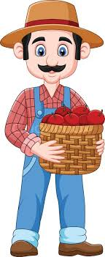

Look, I HAVE got a basket.
Tracy HAS got a basket.

Slide 6


I HAVE got a camera.
Mick HAS got a camera.

Slide 7


I HAVE got a bag.
Greta HAS got a bag.

Slide 8
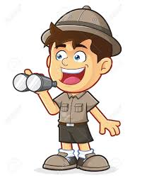

I HAVE got binoculars.
Luke HAS got binoculars.

Slide 9
Copy the sentences into your notebook .
Prepiši ove rečenice u svoju bilježnicu.
Tracy has got a basket. (Tracy ima košaru.)
Luke has got binoculars. (Luke ima dvogled.)

Slide 10
Play the game. Put the words into the order.
Odigraj igru. Složi riječi po redu.
Game

