Slide 1
Reported statements
We use reported statements to say what somebody says or thinks.

Slide 2
Direct speech
Indirect speech
Miss Brown: ‘The Internet is quite safe for children to use.’
Mr Bennett: ‘I don’t know anything about cyberspace.’
Ann: ‘I read an interesting article about endangered species yesterday.’
Miss Brown thinks that the Internet is quite safe for children to use.
Mr Bennett says that he doesn’t know anything about cyberspace.
Ann says that she read an interesting article about endangered species the day before.

Slide 3
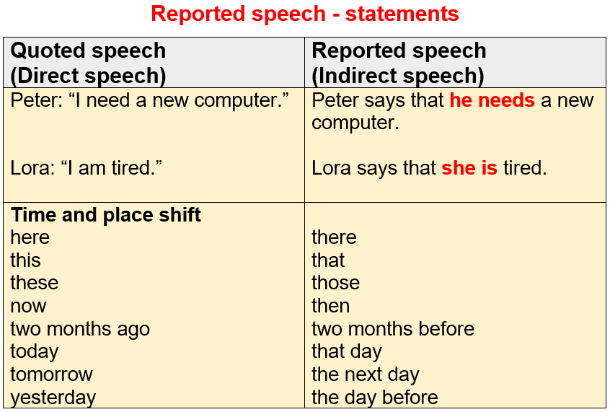

Slide 4
Exercises
http://www.ego4u.com/en/cram-up/grammar/reported-speech/exercises
http://www.ego4u.com/en/cram-up/grammar/reported-speech/exercises?02

Slide 5
Reported commands and requests
Direct Speech
‘Put your old things in the garage.’
‘Please, help me with the homework, Bob’
‘Don’t be late for school.’
‘Don’t forget to return your books to the library.’
Indirect Speech
Mum tells Luka to put his old things in the garage.
(a command)
Tom asks Bob to help him with the homework.
(a request)
Mum tells me not to be late for school.
The librarian tells me not to forget to return my books to the library.

Slide 6
Exercises
https://www.englishexercises.org/makeagame/viewgame.asp?id=12824

Slide 7
Reported questions

Slide 8
Yes-no questions: they start with auxiliary verbs (am, are, will, do, does)
Wh- questions: they start with question words (why, who, when, how)
We introduce the reported questions with: if
‘Do you like computers?’
She asks if I like computers.
‘Did you play computer games yesterday?’
She wants to know if I played computer games yesterday.
(Never use do, does, did in reported speech.)
We introduce the reported questions with: what, when, why + subject + verb
‘When did you ask for help?’
She wants to know when I asked for help.
‘Why are you sad?’
She asks why I am sad.

Slide 9
Exercises
http://www.autoenglish.org/questions/gr.indirect.i.htm
http://www.englishexercises.org/makeagame/viewgame.asp?id=532
http://a4esl.org/q/h/vm/indirectques.html
http://www.e-grammar.org/indirect-question/test1-exercise1/

