Slide 1
Will Future and Going to Future

Slide 2
Form
Will Future will + infinitive | Going to Future am, is, are + going to + infinitive
I will help You will help He will help She will help It will help We will help You will help They will help I will not = won’t help Will you help? | I am going to help You are going to help He is going to help She is going to help It is going to help We are going to help You are going to help They are going to help I’m not going to help. Are you going to help?

Slide 3
Will Future
I will have some tomato soup, please.
instant decision
I will pay you back.
promise
Will you come to my party?
- invitation
I think / hope she will win the race.
- prediction without evidence
Going to Future
A: Why have you bought so many eggs?
B: I am going to bake a cake.
plan (you have already decided what to do)
Look at the clouds. It is going to rain heavily soon.
- prediction with evidence (based on what we can see or hear)

Slide 4
Will Future or Going to Future?
1 What are your plans for the weekend? I ... my granny. (visit)
2 Doris is always late. I’m sure she … late tomorrow. (be)
3 Would you like tea or coffee? I … tea. (have)
4 Look. They … the old oak tree. (cut down)
5 Stop bullying her or I … the teacher. (tell)
6 A: It’s rather cold in here. B: Sorry, I … the window. (close)
7 A: Do you know how to make a PowerPoint presentation? B: Yes, I … you. (show)
8 I feel awful. I think I … sick. (be)
9 A: What is he doing with that hammer? B: He … the painting. (put up)
10 A: I am thirsty. B: Wait here. I … some water. (get)
11 My brother … 15 tomorrow. (be)
12 Her sister … a baby. (have)
1 am going to visit
2 will be
3 will have
4 are going to cut down
5 will tell
6 will close
7 will show
8 am going to be
9 is going to put up
10 will get
11 will be
12 is going to have

Slide 5
Present tenses expressing future

Slide 6
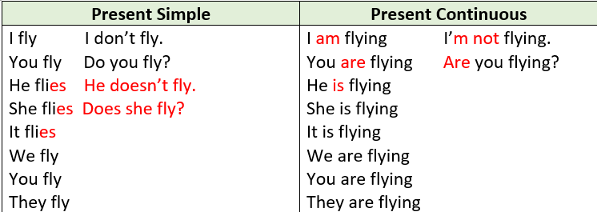

Slide 7
Present Simple
The train arrives at 7 pm.
My English lesson starts at 8 am.
- We use it to talk about timetables.
Present Continuous
We are going to the theatre with our parents tonight.
I am seeing a friend at Mc Donald’s for a burger and a chat.
- We use it to talk about personal arrangements.

Slide 8
Present Simple or Present Continuous?
1 This is a terrible film. When … it …? (finish)
2 The library … in five minutes and I have four books to return before they fine me. (close)
3 Go to the supermarket and buy that special shampoo for the dog. I …him a bath tonight. (give)
4 I can't see you tonight, Jan. I…to the theatre with Mike. (go)
5 The plane … at 10 am. sharp. (take off)
6 She… Tim tonight or ever again. ( not see) They broke up last week.
7 Attention, please! On your marks. The next race… at 9.30. (start)
8 I'm sorry. We can't come at 10 o'clock tomorrow. We… a vet because our cat was hit by a car. (meet)
1 does it finish
2 closes
3 am giving
4 am going
5 takes off
6 isn’t seeing
7 starts
8 are meeting

