Slide 1
The UK and the British Empire

Slide 2
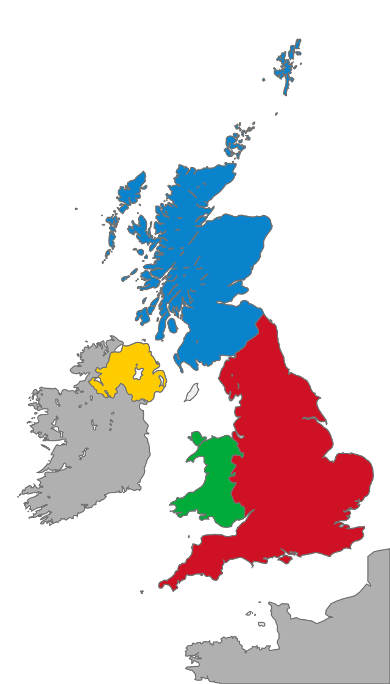
The United Kingdom – a monarchy
Scotland
England
Wales
Northern Ireland

Slide 3
Great Britain – an island
Great Britain is not a state, it is an island.

Slide 4
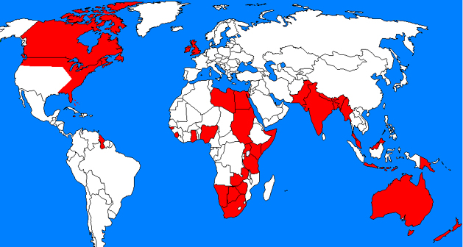
The British Empire
the United Kingdom + the colonies under its rule
the rise: -in the 16th century
-under the rule of Queen
Elizabeth I
at its peak: 24% of the whole world’s territory
the decline: -at the beginning of the
20th century
-colonies started gaining
independence
officially ended in 1997 – Hong Kong was
handed back to China
decline /dɪˈklʌɪn/ pad, opadanje

Slide 5
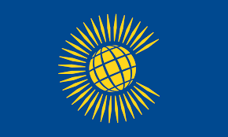
The Commonwealth
a political union
54 equal and free states
once British colonies
formally founded in 1949
the head – Queen Elizabeth II
title not hereditary
equal /ˈiːkwəl/ ravnopravan
head /hɛd/ poglavar
hereditary /hɪˈrɛdɪtəri/ nasljedan
workbook: exercise 1 a, p. 47
exercise 1 b, p. 47

Slide 6
Book, p.40, exercise 2:
Vocabulary
trade
raw materials
influence
indigenous
colonise
reign
legacy
illiterate
enrich
fall apart
the action of buying and selling goods
basic materials before they have been processed
to affect or change something or someone
the first inhabitants; people who originally lived in place
to send people to live in another country and to govern it
to be the queen or king of a country
property you receive (inherit) when somebody dies
unable to read and write
to make someone richer
to break into pieces
Exercise: https://wordwall.net/play/27516/217/690

