Slide 1
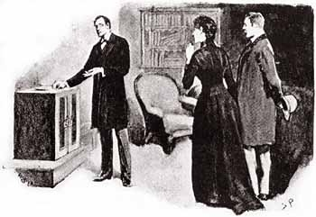
The speckled band

Slide 2

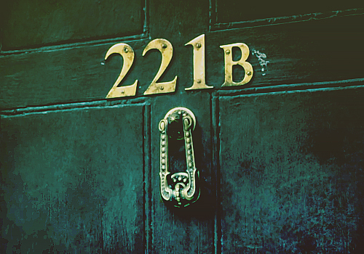
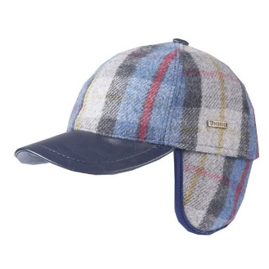
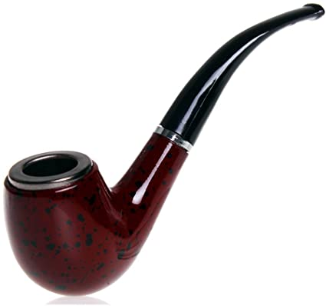
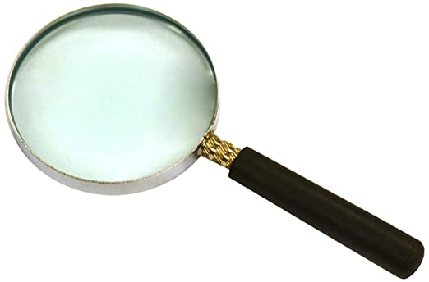
1 Who is this?
2 Where does he live?
3 Who does he live with?
4 What is he like?
5 What objects are characteristic of Sherlock Holmes?
6 Who does Holmes often help solve difficult cases?
1 Sherlock Holmes is a fictional detective created by Sir Arthur Conan Doyle.
2 He lives in London, at 221B Baker Street.
3 He lives with Dr Watson, who helps him solve the most difficult cases and Mrs Hudson, their housekeeper.
4 He is extremely intelligent and has sharp observation skills.
5 A pipe, a magnifying glass and a chequered cap.
6 He often helps Scotland Yard, the London police.

Slide 3
Book, page 37 - answers
1 Helen Stoner visited Sherlock Holmes.
2 She was afraid she would die soon.
3 She and her sister would inherit a fortune if they got married. Her sister died before her wedding and she was getting married soon.
4 She was afraid of her stepfather.
5 Julia was afraid of a strange noise in her room.
6. The police arrested nobody.
7 A monkey and a wild cat lived on Dr Roylott’s property.
8 A strange hole in the wall which led to the stepfather’s room, a metal box and a bowl with some milk in it.

Slide 4
Vocabulary
stepfather
housekeeper
fortune
vagabond
venomous
culprit
evidence
terrifying
whistle
suspect
witness
weapon
suspicious
your mother’s husband who is not your birth father
a person who takes care of someone’s home
a large amount of money
a person without a permanent home so he wanders from town to town
poisonous
a person who has committed a crime, a criminal
a proof
very scary
a high-pitched sound that you make when calling a dog
a person believed to have committed a crime
a person who sees a crime or an accident
any object used in fighting or war
making you feel that something is illegal or wrong

Slide 5
The speckled band, by A. C. Doyle
Sherlock Holmes | a famous fictional detective - Dr Watson and Mrs Hudson A. C. Doyle - intelligent, sharp observation skills at 221B Baker Street, in London - a pipe, a magnifying glass and a chequered cap
Victim | Julia Stoner, Helen’s sister
Killer | Dr. Grimesby Roylott
Motive | the money his late wife left to her daughters in her will
How was the victim killed? | by a venomous snake’s bite

