Slide 1
Dates and years

Slide 2
Writing and saying dates.
Writing dates
1 / 2 or 1st February
2 / 5 or 2nd May
5 / 7 or 5th July
23 / 10 or 23rd October
15 / 11 or 15th November
Saying dates
The first of February
The second of May
The fifth of July
The twenty-third of October
The fifteenth of November

Slide 3
Ordinal numbers
Cardinal numbers | Ordinal numbers -th / - ieth
1 one 2 two 3 three 4 four 5 five 6 six 8 eight 9 nine 11 eleven 12 twelve 13 thirteen 20 twenty 25 twenty-five 30 thirty 31 thirty-one | 1st the first (prvi) 2nd the second (drugi) 3rd the third 4th the fourth 5th the fifth 6th the sixth 8th the eighth 9th the ninth 11th the eleventh 12th the twelfth 13th the thirteenth 20th the twentieth 25th the twenty-fifth 30th the thirtieth 31st the thirty-first

Slide 4
Years
Writing years
(they are cardinal numbers)
1995
1862
1911
1748
Be careful!
2001
2008
After 2010 (two ways)
2011
2021
Saying years
19 95
nineteen ninety-five
eighteen sixty-two
nineteen eleven
seventeen forty-eight
two thousand and two
two thousand and eight
two thousand and eleven
or twenty eleven
two thousand and twenty-one
or twenty twenty-one

Slide 5
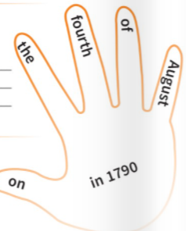
Prepositions: on and in

Slide 6
Say the dates and years.
1 / 3 – 3rd March
5 / 1
11 / 5
12 / 8
22 / 4
23 / 10
31 / 12
15 / 6
8 / 9
1645
1786
1873
2001
2004
2010
2015
2020
On the third of March
On the fifth of January
On the eleventh of May
On the twelfth of August
On the twenty-second of April
On the twenty-third of October
On the thirty-first of December
On the fifteenth of June
On the eighth of September
In sixteen forty-five
In seventeen eighty-six
In eighteen seventy-three
In two thousand and one
In two thousand and four
In two thousand and ten / in twenty ten
In two thousand and fifteen / in twenty fifteen
In two thousand and twenty / in twenty twenty

