Slide 1
Describing people
What do you look like?
What are you like?
What do you like?

Slide 2
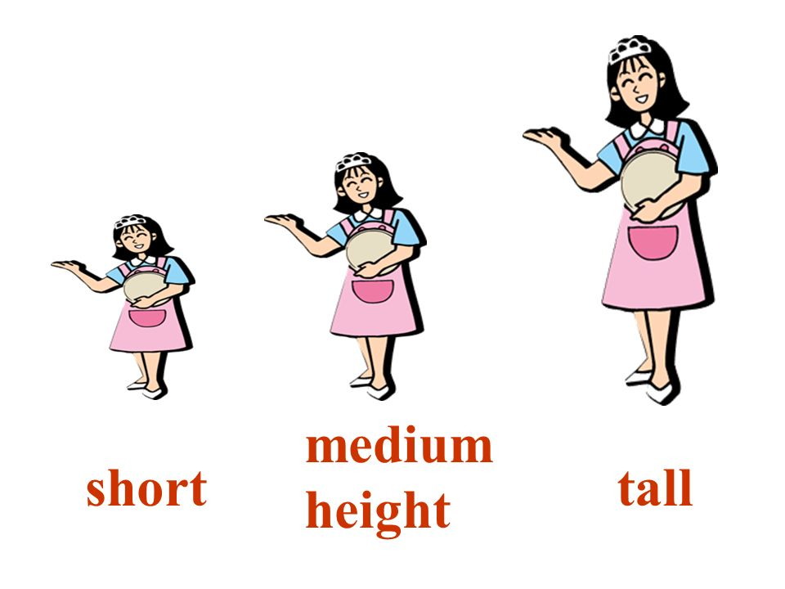
What do you look like?
What are you like?
Age: young, old, middle-aged
Build: slim, overweight, skinny, well-built
Height: tall, medium height, short
Face: oval, long, round, …
hair: blonde, ginger, straight, curly, wavy, short, middle-length, long, …
Eyes: big, narrow, blue, black, …
Nose: turned-up, hawk nose, Greek nose, …
Lips: full, thin, heart-shaped, …
friendly, out-going, shy, honest,
generous, a bit lazy, hard-working,
curious, ambitious, sporty, cheerful, helpful, …

Slide 3
What do you like?
I like …
playing sports
listening to music
helping abandoned animals/dogs and visiting dog shelters
watching films
reading books
hanging out with my friends
doing household chores

