Slide 1
On the way to school
How do children get to school?

Slide 2
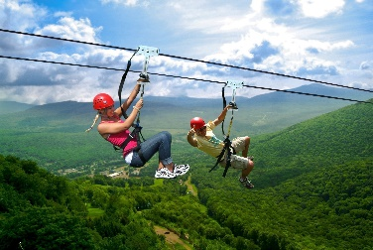
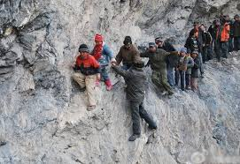
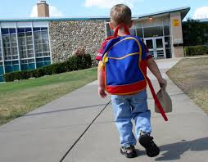
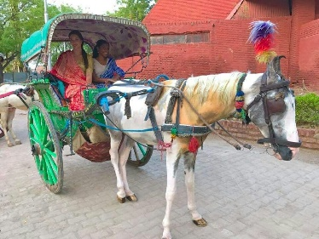
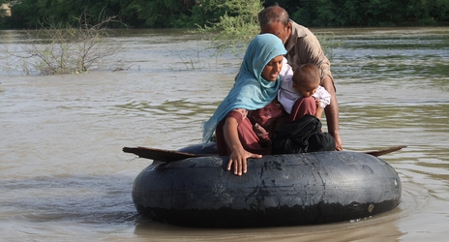
Live close to school Live a long way from school (by bus, by tram, by car)
slide down a zipline
cross mountains
take a ride on a horse
and cart
cross the river on
a car tyre
on foot

