Slide 1
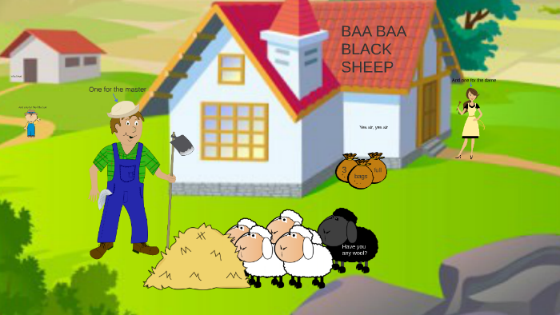
A MASTER
A LITTLE BOY
A DAME
A BLACK SHEEP

Slide 2
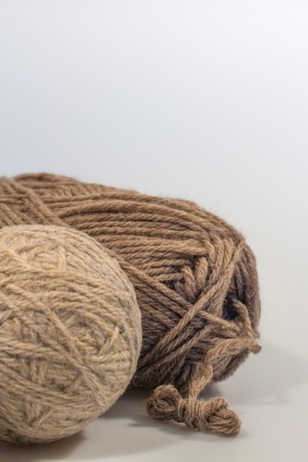
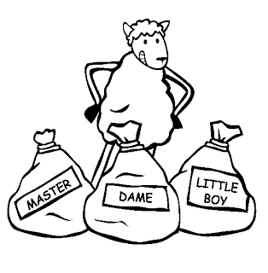

Slide 3
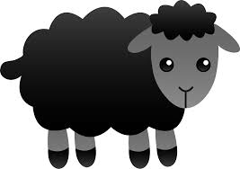
BA – BA
?

Slide 4
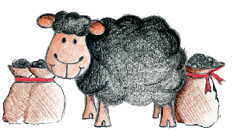
YES
MASTER
DAME
LITTLE
BOY

