Slide 1
Animals
Sayings and phrases

Slide 2
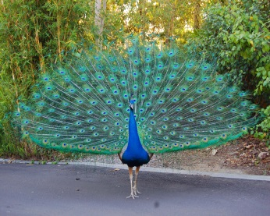

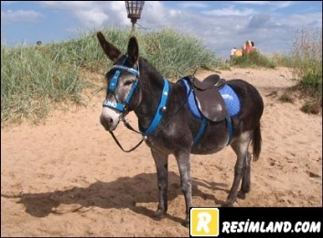
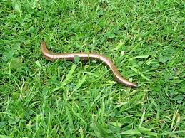
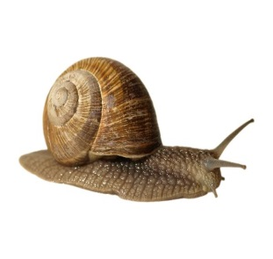
Animals in everyday expressions
Has the .......got your tongue?
The young Prince was as proud as a.......
My grandma says she is as blind as a ...........
This waiter is as slow as a .........
My kid sister is often as stubborn as a .........
She goes to the library twice a week. She is a real book ....
The farmer’s daughter is as busy as a .....
The boy sat in the corner as quiet as a .....
Peacock
Mouse
Cat
Bat
Bee
Mule
Snail
Worm

Slide 3
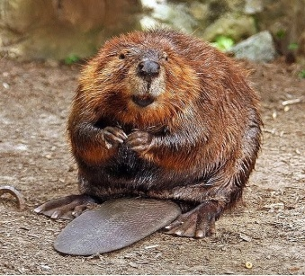
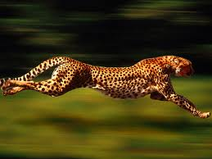
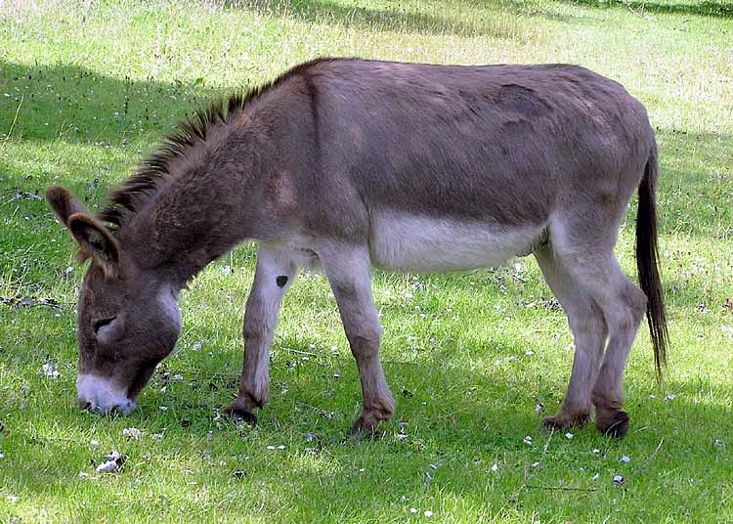
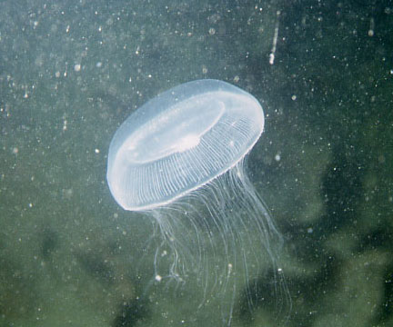
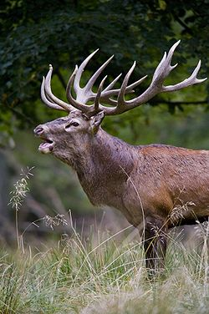
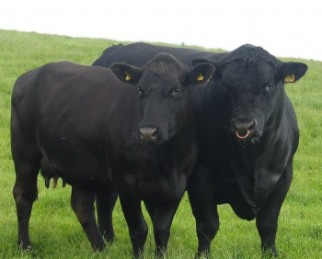
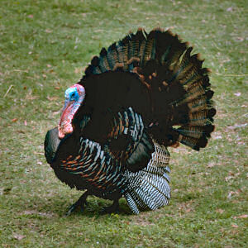
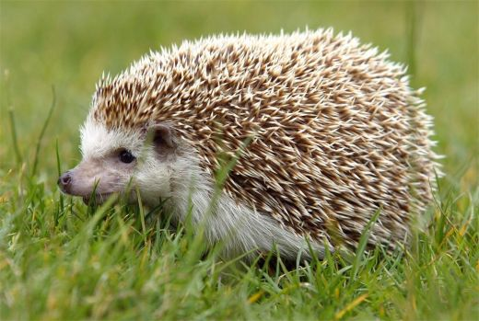
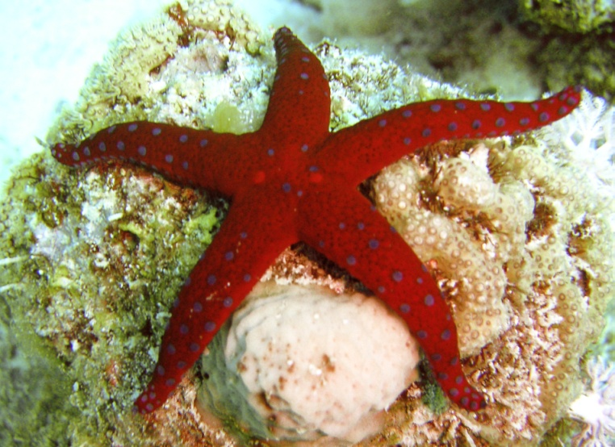
Match the animals and their habitat
A beaver 1
A bear
A deer
A hedgehog
a tiger
A cobra
A panda
A hyena
A cheetah 9
A giraffe
A lion
A donkey
A cow and a bull 12
A whale
A sardine
A shark
A sea star 13
A jelly fish
A duck
A goose 17
A turkey
Poultry farms
The sea
Africa
Cattle farms
European forests
Asia
18 3
21
4

