Slide 1
The world
Vocabulary

Slide 2
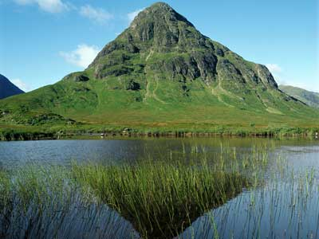
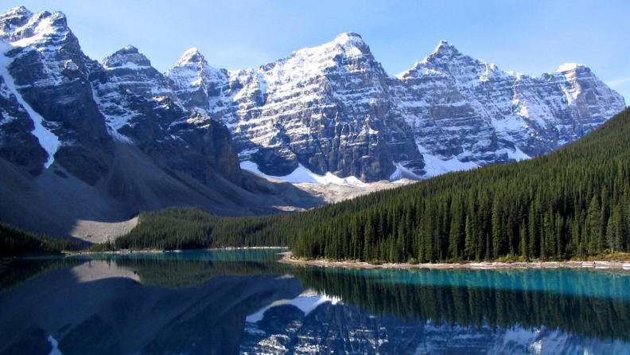
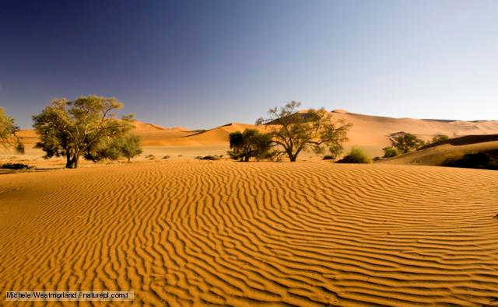
a mountain
a mountain range
a desert

Slide 3
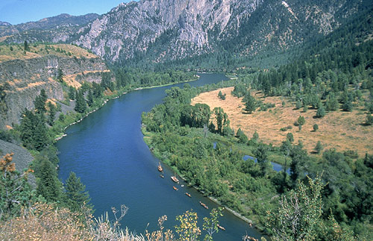
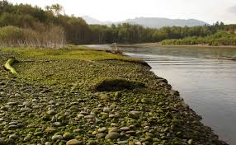
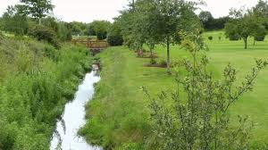
a river
a river bank
a brook

Slide 4
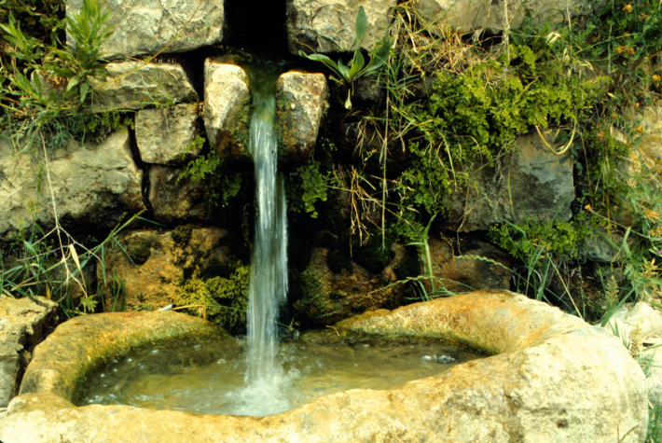
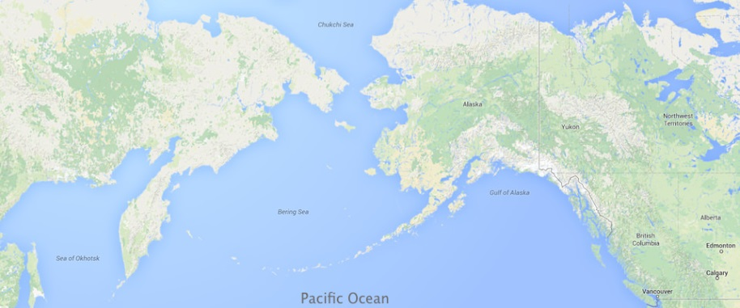
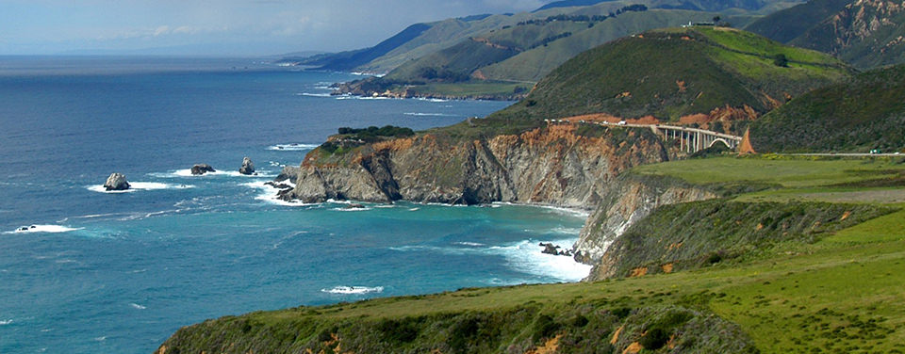
a spring
an ocean
a coast

Slide 5
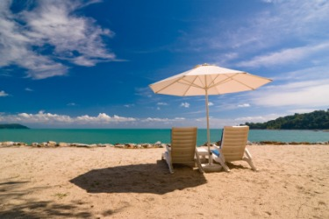
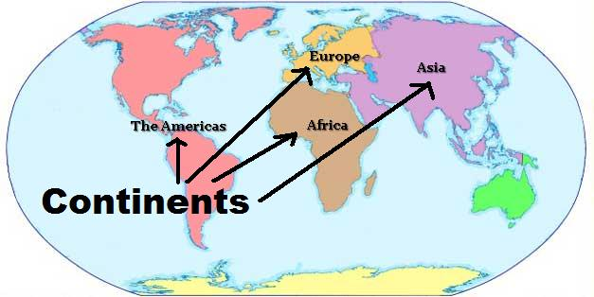
a beach
a continent

Slide 6
Fill in the blanks.
.......Učka is in Croatia.
The ........ Sava runs through Zagreb.
The Sahara ........ is in Africa.
The Adriatic ....... is beautiful.
The Atlantic ..... is between Europe and America.
I build sandcastles on the ........ in summer.
Mountain
River
Desert
Coast
Ocean
beach

