Slide 1
Getting to know each other

Slide 2
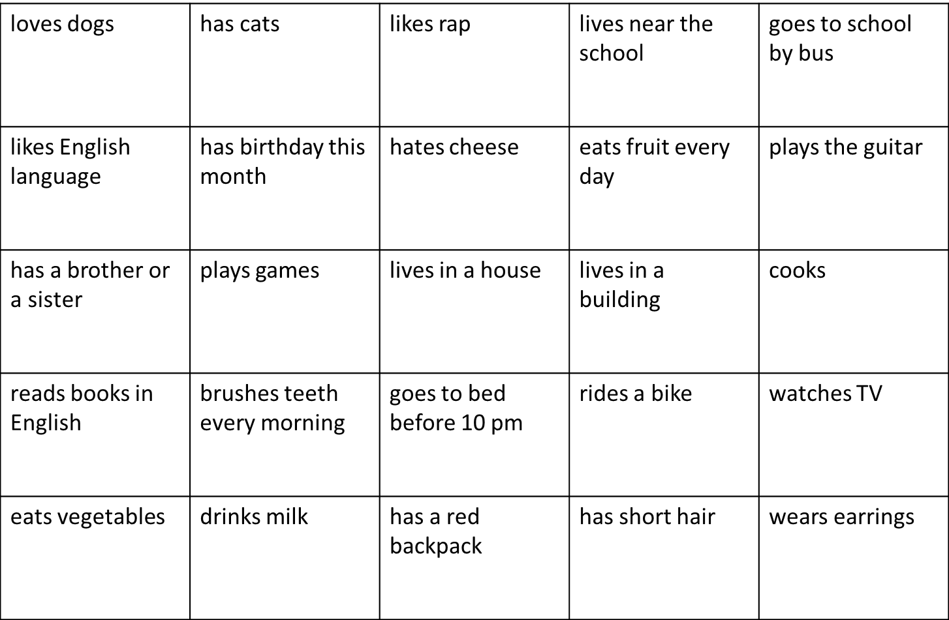










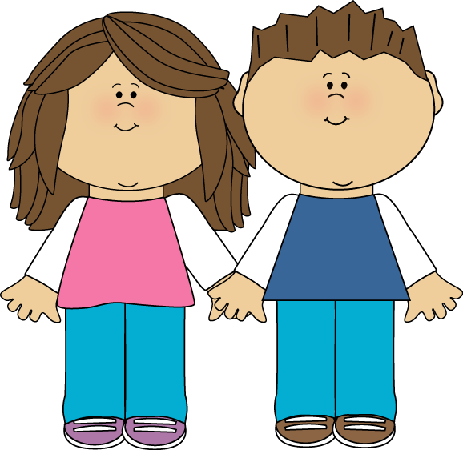


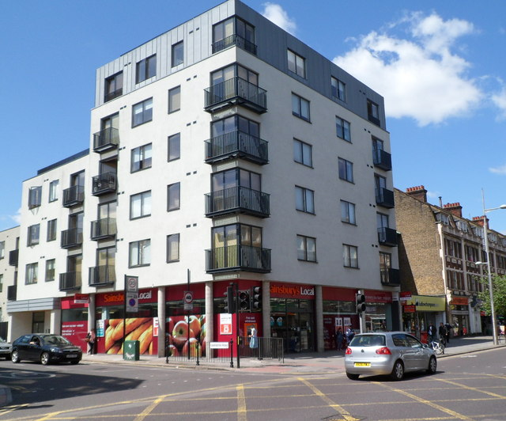
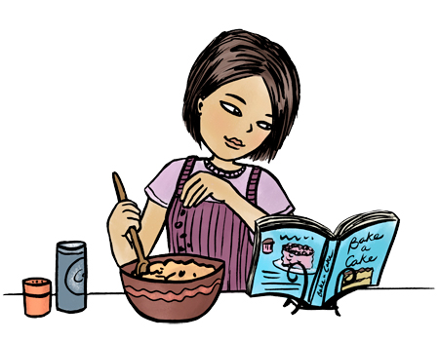





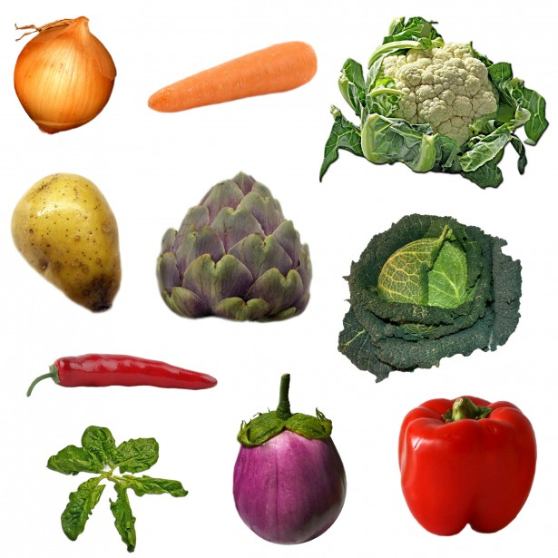


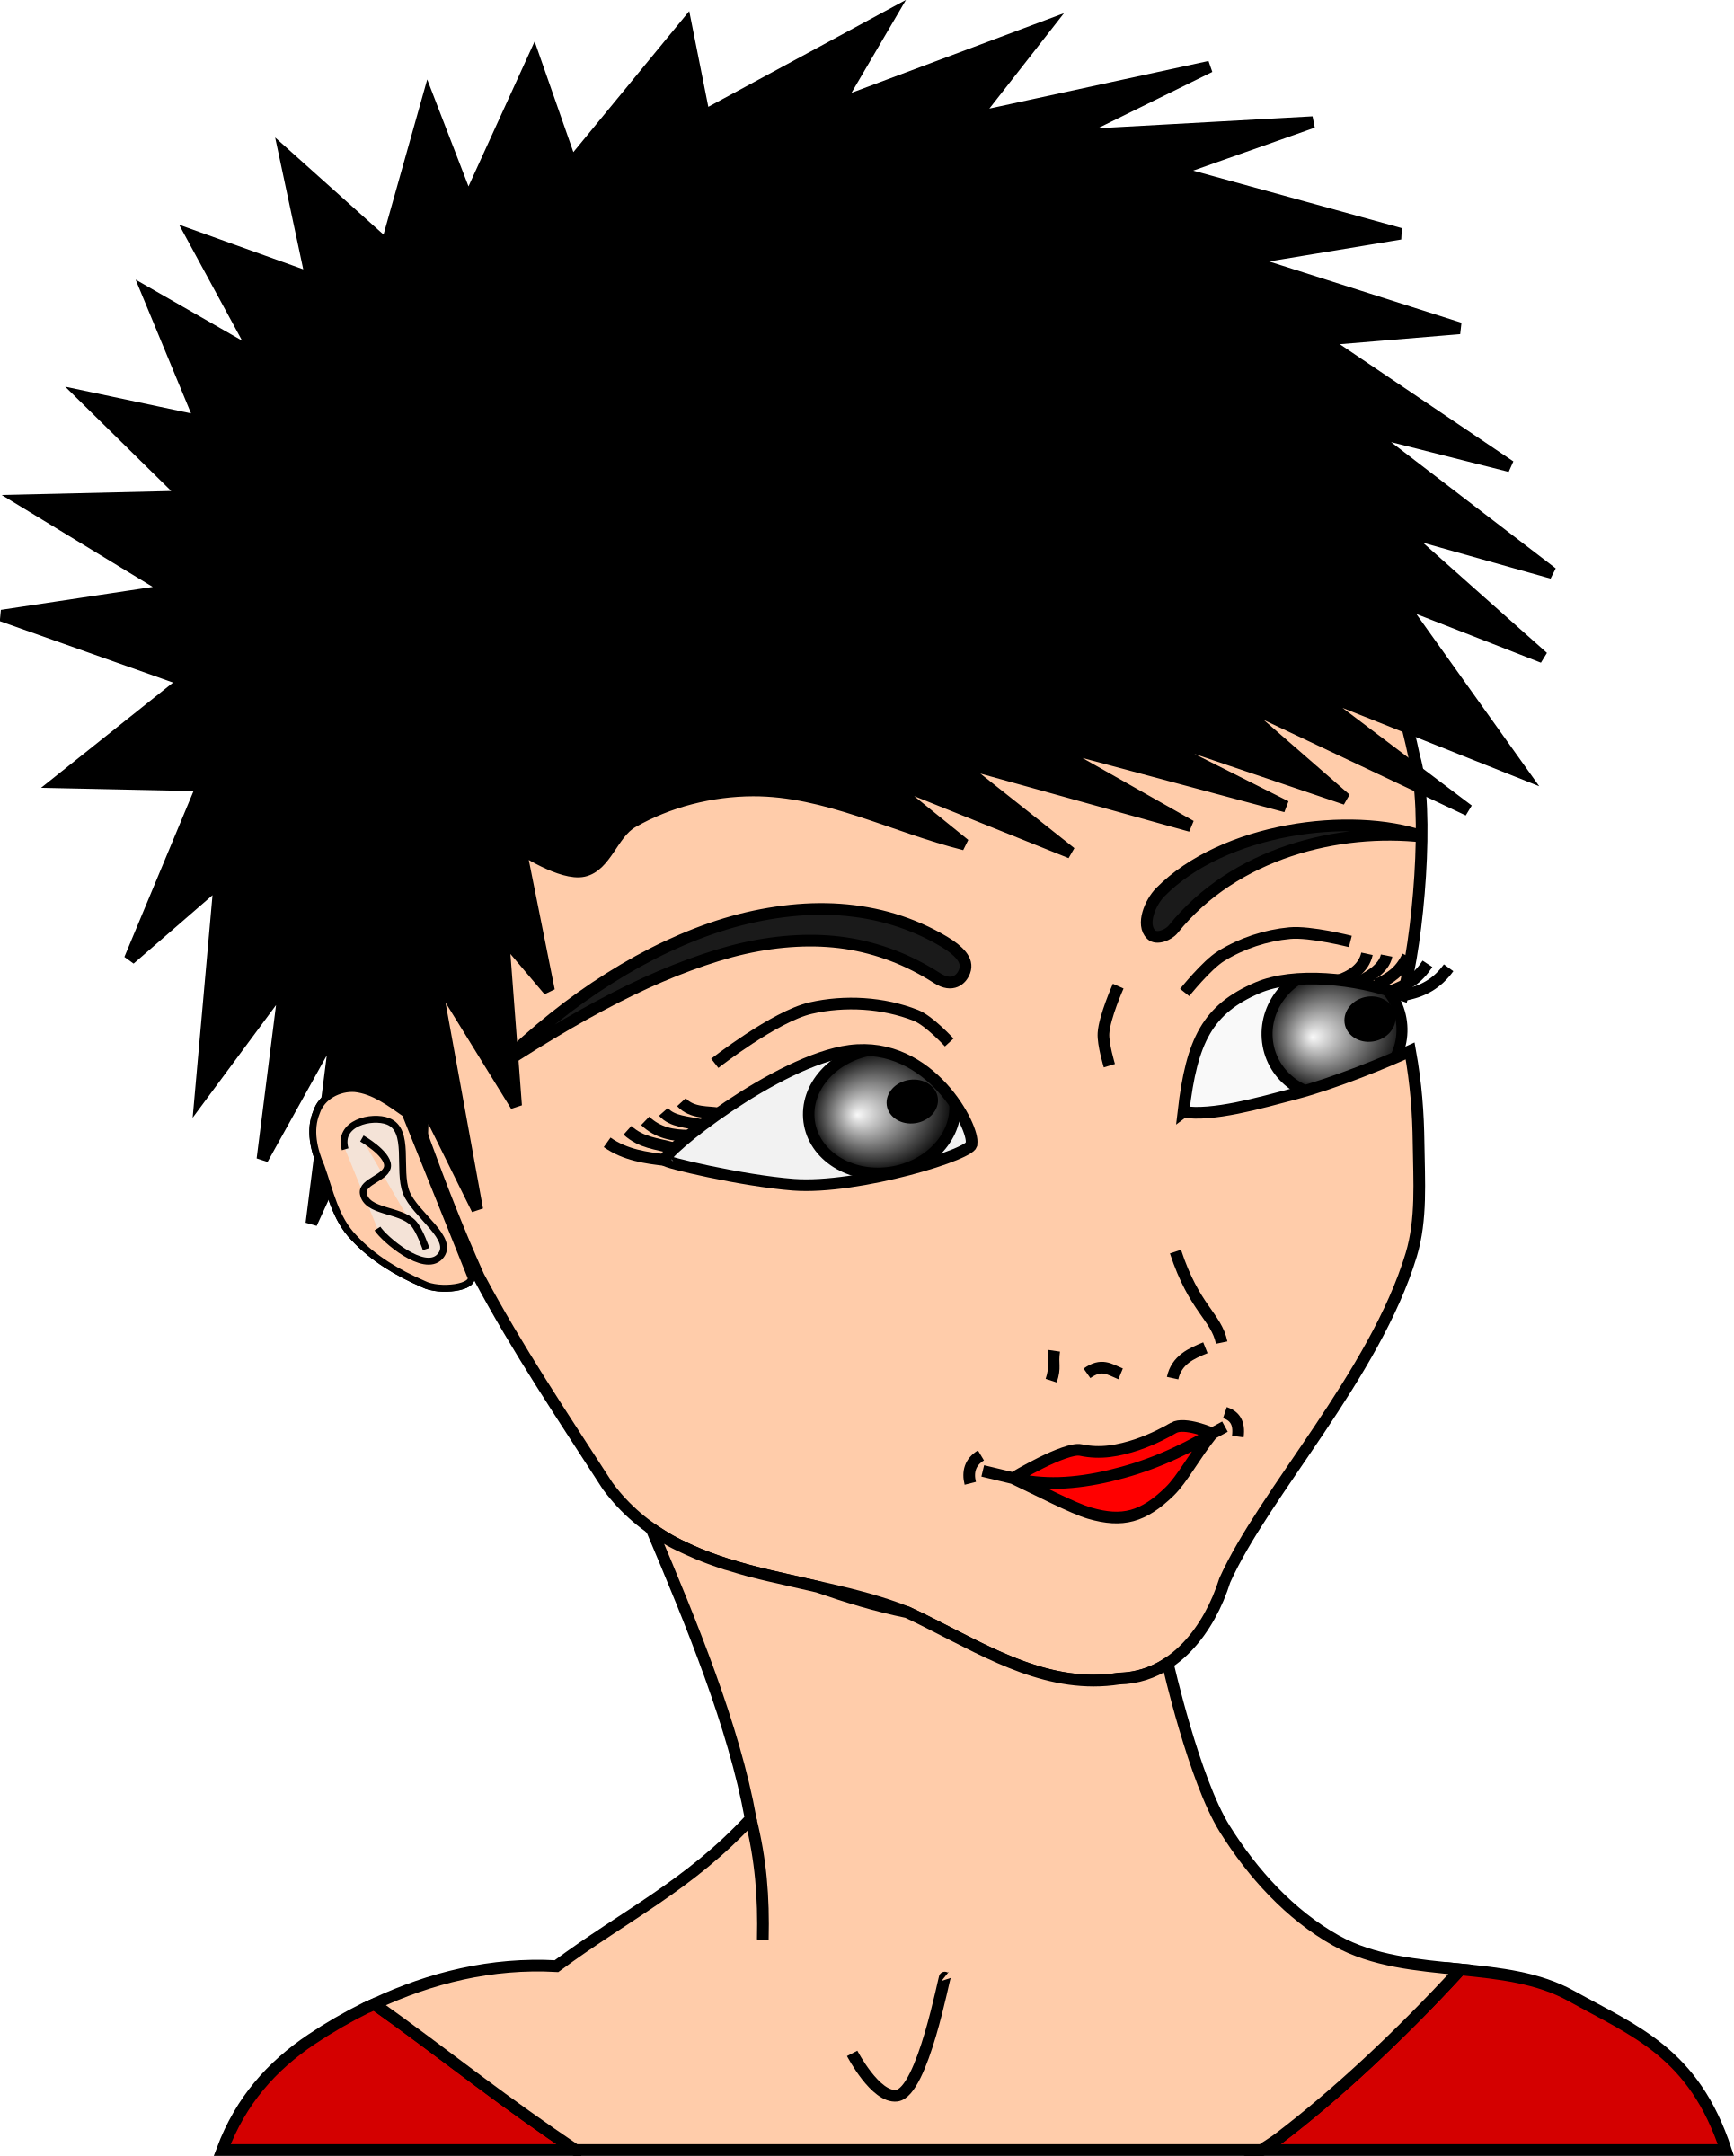

Find someone who

Slide 3
Talk to your friends
Do you love dogs?
Do you have a cat?
Do you like rap?
Do you live near the school?
Do you go to school by bus?
a

