Slide 1
Wee Willie Winkie

Slide 2
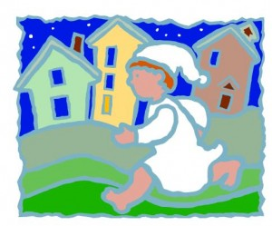
Wee Willie Winkie runs through the town.
run through the town
trčati kroz grad

Slide 3
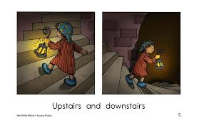
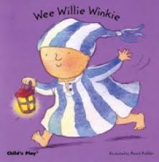
upstairs and downstairs in his nightgown
upstairs and downstairs
penjati se i silaziti niz stepenice
nightgown - spavačica

Slide 4
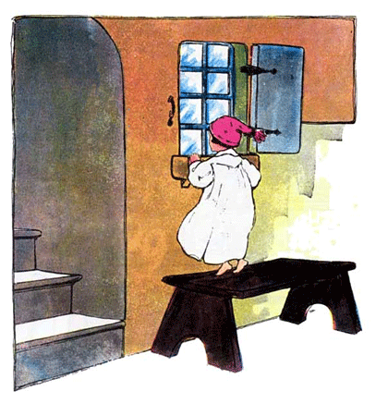
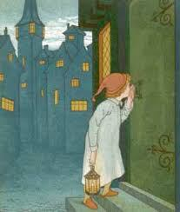
Willie is knocking at the window.
He is calling through the lock.
knock – kucati
lock – ključanica

