Slide 1
Teenscene jobs
Vocabulary

Slide 2
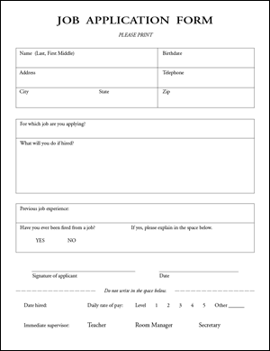
application form – an official request in a form of a letter
advert /ˈædvɜːt/ an advertisement

Slide 3
male /meɪl/ a boy
female /ˈfiːmeɪl/ a girl
hard-working /ˌhɑːdˈwɜːkɪŋ/ always doing a lot of work, marljiv
style hair – do hair
extra /ˈekstrə/ a person in a film who does not have a speaking part (e. g. in a crowd), statist
confident /ˈkɒnfɪdənt/
self-assured

Slide 4
duty /ˈdʒuːti/ something you have to do as a part of your job
polite /pəˈlaɪt/ mannerly, civil
under pressure /ˈpreʃər/ in a difficult situation
smart /smɑːt/ having a clean and tidy appearance
wage /weɪdʒ/ money that is paid every week, nadnica

Slide 5
responsible /rɪˈspɒnsəbəl/ having a good judgement and the ability to act correctly, odgovoran
reliable ​ /rɪˈlaɪəbəl/ someone who can be trusted, pouzdan
involve /ɪnˈvɒlv/ include, uključiti
trolley /ˈtrɒli/

Slide 6
Write the words and translate them.
............. /pəˈlaɪt/
............. /ˈpreʃər/
............. /smɑːt/
.............. /weɪdʒ/
............. /rɪˈspɒnsəbəl/
.............. /rɪˈlaɪəbəl/
.............. /ɪnˈvɒlv/
............ /ˈtrɒli/
E. g.
advert /ˈædvɜːt/ oglas
........... /ˈædvɜːt/
........... /ˌhɑːdˈwɜːkɪŋ/
........... /meɪl/
........... /ˈfiːmeɪl/
........... /ˈekstrə/
............ /ˈkɒnfɪdənt/
........... /ˈdʒuːti/

