Slide 1
Teenagers and money
Vocabulary

Slide 2
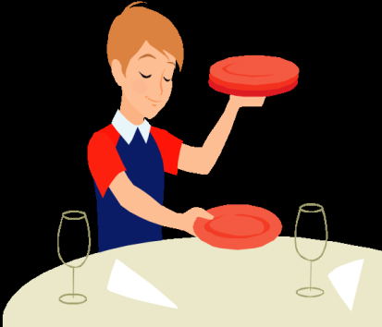
pocket money /ˈpɒkɪt ˌmʌni/
the money that parents regularly give to their children
hoover the floor
wash up
set the table

Slide 3
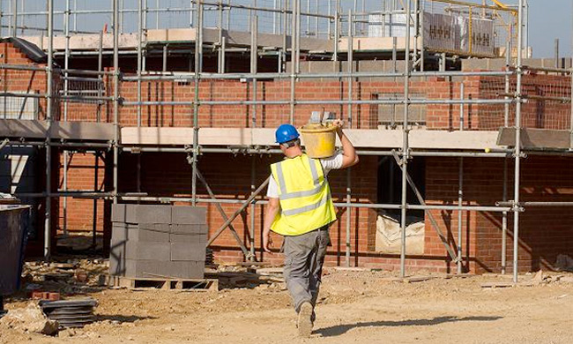
a part-time job – you work only few hours a day
restiction /rɪˈstrɪkʃən/ limit
building site /ˈbɪldɪŋ ˌsaɪt/

Slide 4
Write the words and translate them.
............./ˈpɒkɪt ˌmʌni/
........... /rɪˈstrɪkʃən/
........... /ˈbɪldɪŋ ˌsaɪt/
.......... /ˈhuːvə/
.......... /’wɒʃ’ᴧp/
........ /ˌpɑːtˈtaɪm/
E. g.
pocket money /pɒkɪt ˌmʌni/ džeparac

