Slide 1
Jobs

Slide 2
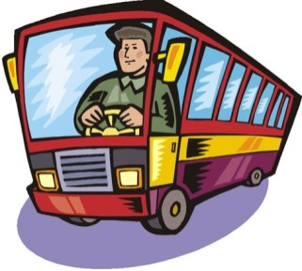
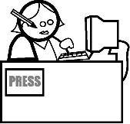
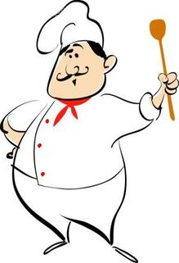
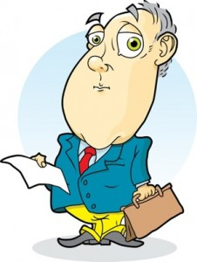
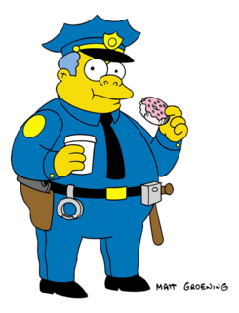
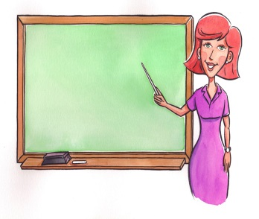
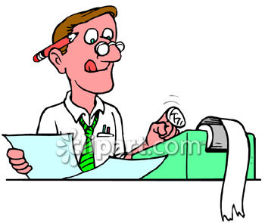
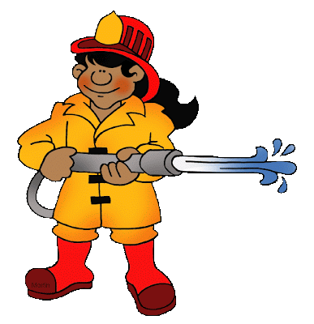
2) 2)
a bus driver a journalist
3) 4)
a teacher a police officer
5) 6)
an accountant a nurse
7) 8)
a manager a chef
9) 10)
a waiter a lawyer
12)
a secretary a fireman

Slide 3
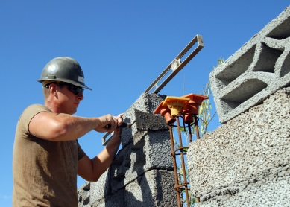
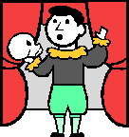
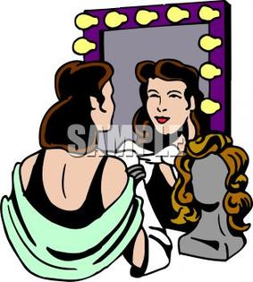
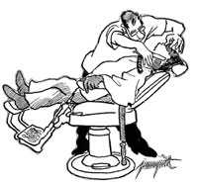
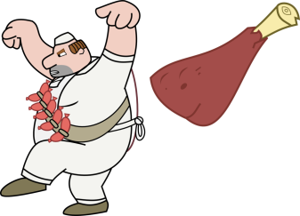
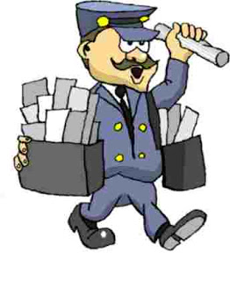
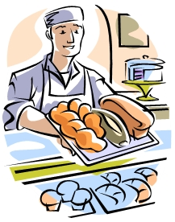
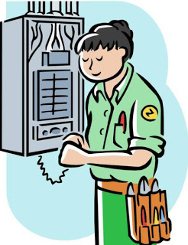
14) 14)
an optician a builder
15) 16)
a butcher a barber
18)
a hairdresser a postman
19) 20)
an actor an actress
21) 22)
an artist a singer
23) 24)
a baker an electrician

Slide 4
Match the jobs to the definitions
An architect
An accountant
A lawyer
A pilot
A surgeon
A carpenter
A plumber
A vet
installs and repairs systems used for drinking water
represents and defends people with legal problems
looks after and treats animals
flies planes and helicopters
controls the financial situation in a company
designs buildings
operates on patients
creates things out of wood

Slide 5
Unusual jobs
Listen to the interview and choose the right option.
1) Daniel Ash wrote a
a) novel b) a song c) a book.
2) In the book he collected stories from
a) the USA b) all over the world c) the UK
Brad Fields
a)cleans chewing gum off the streets of New York b) paints graffiti c) takes out the rubbish
4) Food stylists
a) eat food in advertisements b) make food look good in advertisements c) buy food for advertisements
5) There are about
a) 200 food stylists in Great Britain b) 12 food stylists in GB c) 20 food stylists in GB
6) Vermiculturalists are
a) worm farmers b) people who eat worms c) people who keep worms as pets

Slide 6
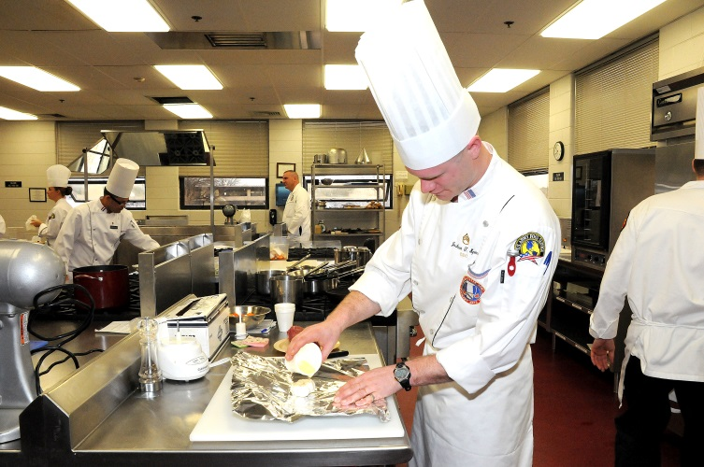
What does Steven do?
He
is
a chef.

