Slide 1
Would you dare?
Tattoos

Slide 2
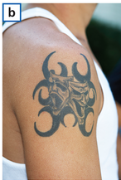
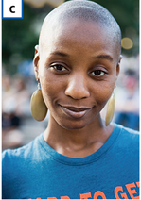
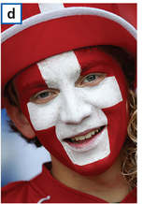
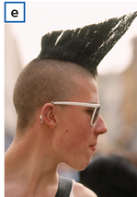
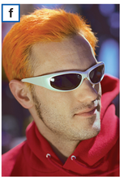
Match the sentences to the photos.
He painted his face in his team’s colours.
She has her tongue pierced.
He dyed his hair orange.
She shaved her head.
He has an unusual hairstyle.
He has a tattoo.

Slide 3
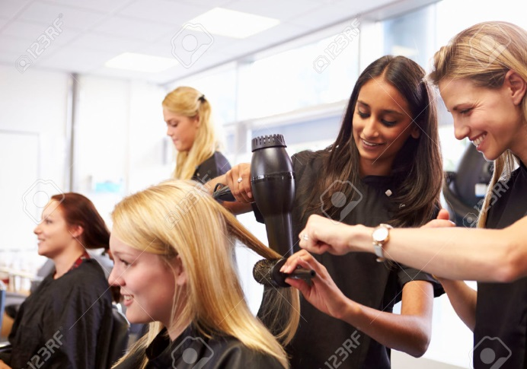
Would you have a tattoo?
My parents would go crazy.
There is a hairdresser’s over there.

Slide 4
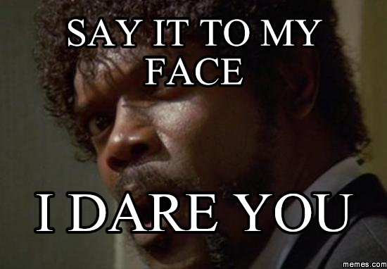
dye /daɪ/ to change the colour
I dare you. = Would you take a risk?

Slide 5
Tattoos
Positive sides
Negative sides
express your individuality
can hide unpleasant scars
can be very creative
very popular today; all classes of people like tattoos
permanent – cannot be removed completely (a special laser operation which is very expensive)
people’s prejudices – people will judge you
could cause infection if not done at a professional salon (sanitary needles, professional tattoo artists)

Slide 6
Would you have a tattoo?
describe the positive sides
describe the negative sides
explain why you would or wouldn’t have a tattoo

