Slide 1
Volunteering
Vocabulary

Slide 2
They work with elderly and disabled people.
They do this once a month.
It can help them when they apply for a job.
Young people do volunteer work abroad.
elderly /ˈeldəli/ polite word for old
disabled /dɪˈseɪbəld/ not having a physical or mental ability that most people have
once /wʌns/ one single time
apply /əˈplaɪ/ to write a request
abroad /əˈbrɔːd/ in foreign countries

Slide 3
Some help in orphanages and hospitals.
They like their independence and they don’t want to go to a care home.
It helps you to appreciate things that you’ve got.
orphanage /ˈɔːfənɪdʒ/ a home for children without parents
independence /ˌɪndɪˈpendəns/ to live without being helped by other people
care home /ˈkeə ˌhəʊm/ a place where old people live when they need help
appreciate /əˈpriːʃieɪt/ to be grateful

Slide 4
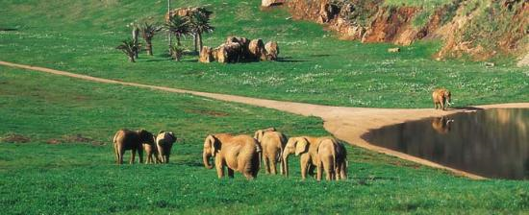
Local people set up a community.
They want to turn the land into a wildlife park.
set up /ˈsetʌp/ to start, to organize
turn into – to change into something else
wildlife /ˈwaɪldlaɪf/ animals/plants living in natural conditions

Slide 5
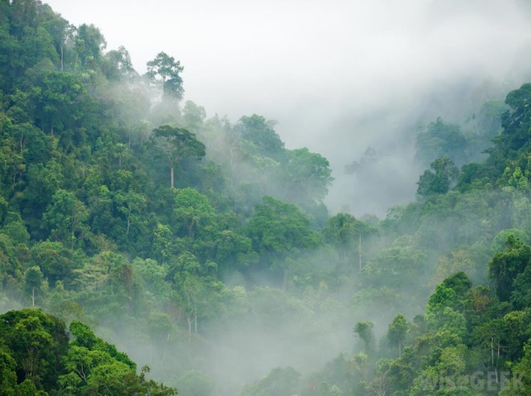
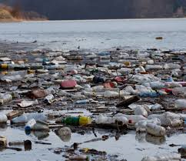
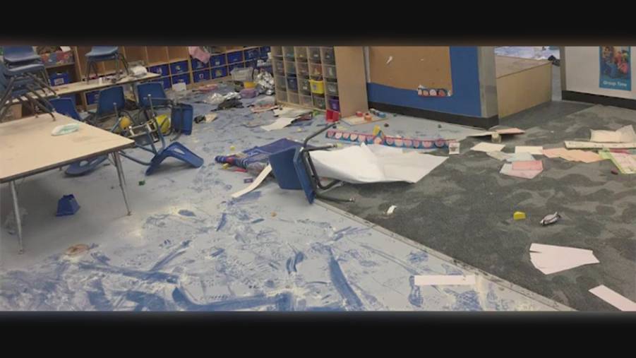
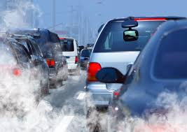
There is no point campaigning about the rainforest if your own area is polluted and vandalized.
rainforest /ˈreɪnfɒrɪst/ a tropical forest
pollute /pəˈluːt/ to make dirty or harmful to people, animal and plants
vandalize /ˈvændəlaɪz/ to damage, to destroy

Slide 6
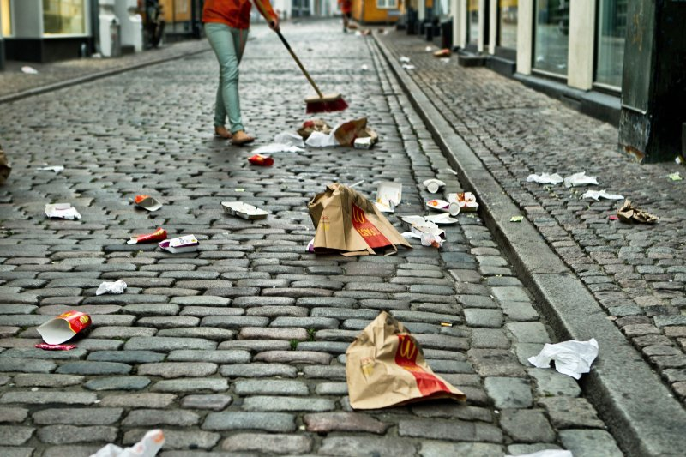
Since we started there’s been a different attitude in the neighborhood and less litter and vandalism.
attitude /ˈætɪtʃuːd/ opinion
litter /ˈlɪtər/ rubbish in public places

Slide 7
Write the words and translate them.
........... /əˈpriːʃieɪt/
........... /ˈsetʌp/
.......... /ˈwaɪldlaɪf/
......... /ˈreɪnfɒrɪst/
........... /pəˈluːt/
......... /ˈvændəlaɪz/
.......... /ˈætɪtʃuːd/
........... /ˈlɪtər/
E. g.
elderly /ˈeldəli/ starija osoba
.......... /ˈeldəli/
......... /dɪˈseɪbəld/
........ /wʌns/
........ /əˈplaɪ/
......... /əˈbrɔːd/
........ /ˈɔːfənɪdʒ/
........ /ˌɪndɪˈpendəns/
......... /ˈkeə ˌhəʊm/

