Slide 2
Present Simple

Slide 3
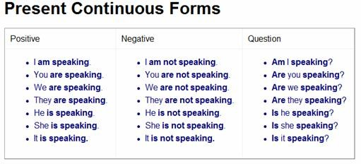

Slide 5
Exercises
Present Simple
Present Simple (neg. sent.)
Present Simple (quest.)
Present Continuous
Present Simple vs Present Continuous

Slide 6
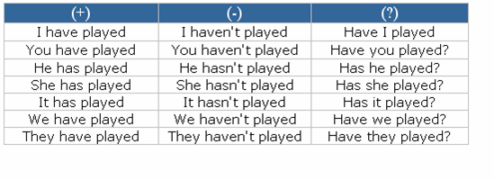
Present Perfect Simple

Slide 7
Present Perfect Continuous

Slide 9
Exercises
Present Perfect Simple
Present Perfect Continuous
Present Perfect Simple vs Continuous
Present Perfect Simple vs Continuous 2

Slide 10
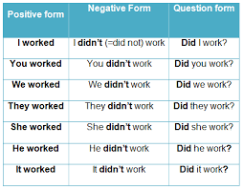
Past Simple

Slide 11
Past Continuous

Slide 13
Exercises
Past Simple
Past Simple (neg. sent.)
Past Simple (quest.)
Past Simple vs Continuous
Past Simple vs Continuous 2
Past Simple vs Continuous 3

Slide 14
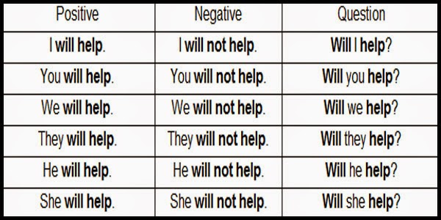
Simple Future

Slide 15
Going to Future

Slide 17
Exercises
Simple Future
Going to Future
Simple Future vs Going to Future
Tenses mixed

