Slide 1
Smart Alec’s plan
Vocabulary

Slide 2
award /əˈwɔːd/ to give money or prize
environment /ɪnˈvaɪrənmənt/
the air, water and land on which we live
replace /rɪˈpleɪs/ to take the place of something
fake /feɪk/ not real, an imitation

Slide 3
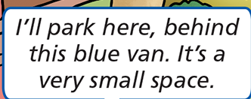
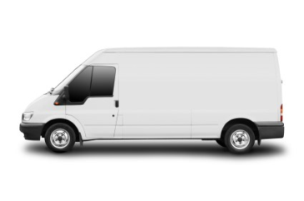
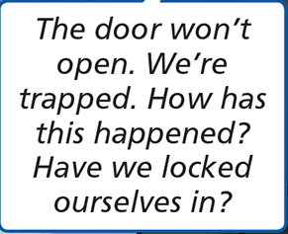
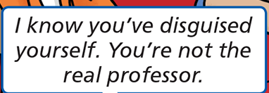
A
van /væn/ a vehicle used for transporting goods
trap /træp/ catch in a trap
lock /lɒk/ shut in by locking a door
disguise/dɪsˈɡaɪz/ give a new appearance to a person

Slide 4
Write the words and translate them.
..................... /əˈwɔːd/
..................... /ɪnˈvaɪrənmənt/
.................... /rɪˈpleɪs/
.................... /feɪk/
................... /væn/
................... /træp/
.................. /lɒk/
................. /dɪsˈɡaɪz/
E. g.
award /əˈwɔːd/ nagrada

