Slide 1
Rosy is worried
Vocabulary

Slide 2
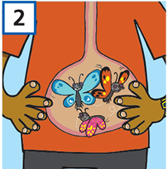
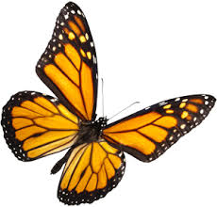
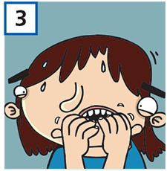
My legs feel like jelly.
jelly /ˈdʒeli/ sweet soft food of fruit and sugar
2) I’ve got butterflies in my stomach.
butterfly /ˈbʌtəflaɪ/
3) I’m really nervous.

Slide 3
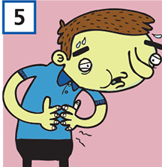
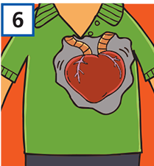
4) My hands are shaking.
shake /ʃeɪk/ shiver
5) I feel sick.
sick /sɪk/ ill
6) My heart’s pounding.
pound /paʊnd/ beat or hit repeatedly

Slide 4
She won’t be long.
I’m dealing with it.
I’m starving.
She won’t take too much time.
I’m solving the problem.
deal /diːl/ to take action
I’m hungry to death.
starve /stɑːv/ to be very hungry

Slide 5
Write the words and translate them.
.............. /ˈdʒeli/
.............. /ˈbʌtəflaɪ/
............. /ʃeɪk/
............ /sɪk/
............ /paʊnd/
........... /diːl/
........... /stɑːv/
E. g.
jelly /ˈdʒeli/ žele

