Slide 1
Problem page
Vocabulary

Slide 2
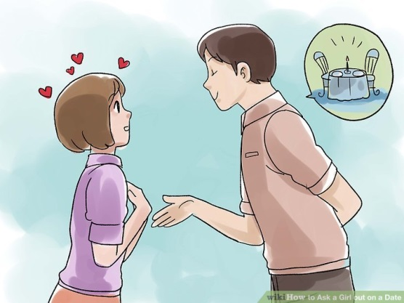
He asked me out on a date.
Your whole adult life is in front of you.
She wants more freedom from her parents.
She eats on her own.
to invite someone to go out
adult /ˈædʌlt/ a person who is over 18 years old
freedom /ˈfriːdəm/ not being restricted or controlled
on her own - alone

Slide 3
Her advice is to talk to parents.
It’s difficult to ignore something that’s written down.
I used to get on well with my parents.
A calm discussion is better than an argument.
advice /ədˈvaɪs/ to offer an opinion in order to help
ignore /ɪɡˈnɔːr/ not pay attention to something
get on well – to have a good relationship
argument /ˈɑːɡjəmənt/
an exchange of opposite views

Slide 4
Write the words and explain them.
.................... /ˈædʌlt/
.................... /ˈfriːdəm/
.................... /ədˈvaɪs/
................... /ɪɡˈnɔːr/
................... /ˈɑːɡjəmənt/
E.g.
adult /ˈædʌlt/ odrasla osoba

Slide 5
Word formation: nouns and verbs.
VERBS
to argue
to discuss
to adjust
to decide
to solve
to choose
to agree
to disagree
to advise /ədˈvʌɪz/
NOUNS
an argument
a discussion
an adjustmen
a decision
a solution
a choice
an agreement
a disagreement
some advice /ədˈvʌɪs/ (no plural)

Slide 6
Match the nouns to the verbs: decision, discussion, adjustment, argument, some advice, solution, choice, agreement, disagreement.
an argument
a discussion
a disagreement
an adjustment
a decision
a choice
a solution
an agreement
some advice
HAVE
MAKE
FIND
REACH
GIVE

Slide 7
Fill in the sentences.
We reached .......... and signed a contract.
I hope you will make a right ........... .
I had ......... with my mum. I don’t know how to make up with her.
We are having ..... about the environment.
I’ll make a few...... and the computer will work fine.
Make .........! You can buy the blue sneakers or the white ones.
I hope we will find ........ that satisfies everybody.
Let me give you some ..... ! Don’t ever lie to me again!
an agreement
2) decision
3) an argument
4) a discussion
5) adjustments
6) a choice
7) a solution
8) advice

