Slide 1
Vocabulary
Unit 4

Slide 2
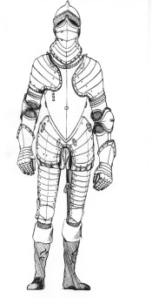
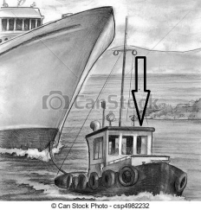
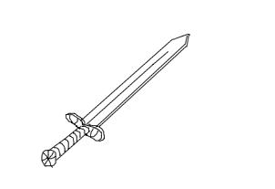
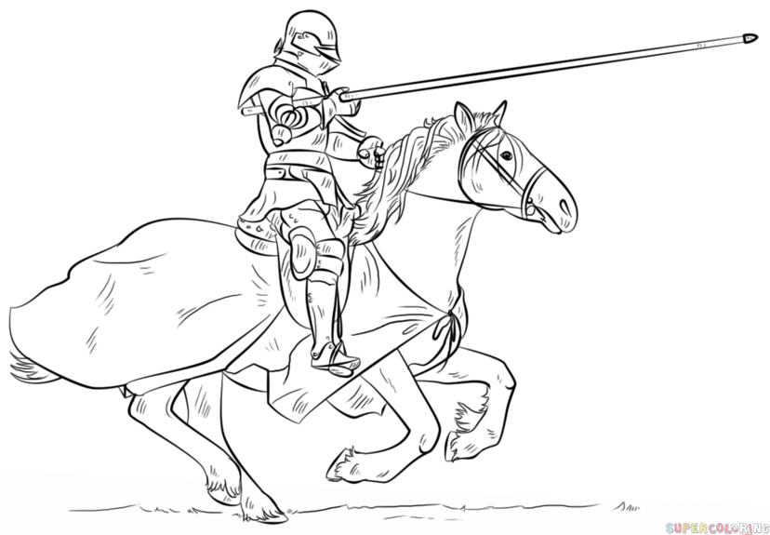
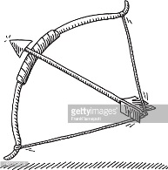
Label the pictures.
1) 2) 3) 4 4)
5) 6) 7)
8) 9) 10)
1 flag
2 crown
3 armour
4 helmet
5 shield
6 tugboat
7 sword
8 knight
9 spear
10 bow and arrow

Slide 3
Listen and choose the right word.
burglary
promise
an outlaw
weak
sunset
a throne
g) handcuffs
h) escape
i) a gate
j) a breaker’s yard
k) a battle
l) vote

