Slide 1
The customer
Vocabulary

Slide 2
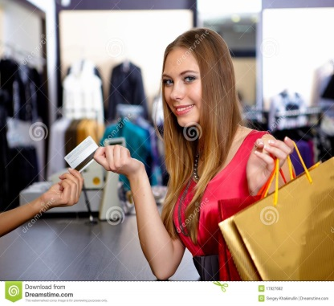
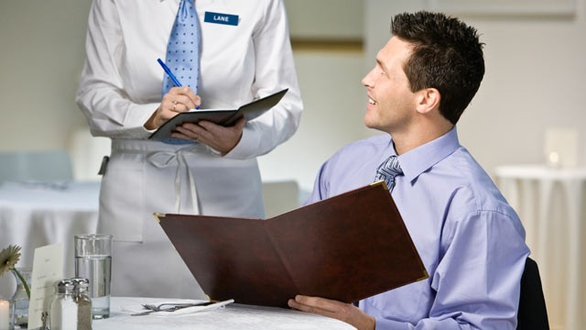
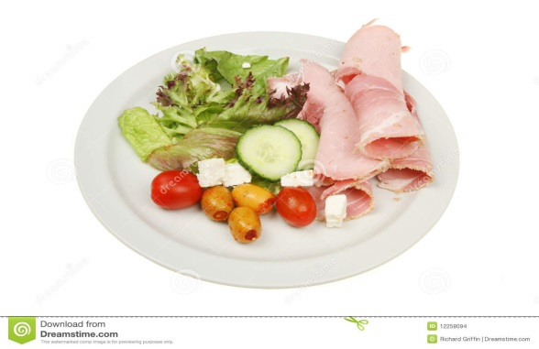
customer /ˈkʌstəmər/ a person who buys things or a service
ham salad
drop /drɒp/ to allow something to fall

Slide 3
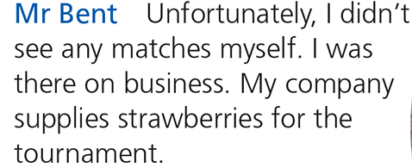
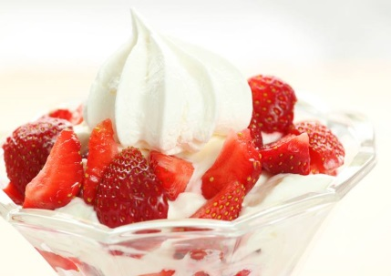
unfortunately – nažalost
supply /səˈplaɪ/ to provide something
afford /əˈfɔːd/ to be able to buy something
fault /fɒlt/ to do something wrong

