Slide 1
The burglar
Vocabulary

Slide 2
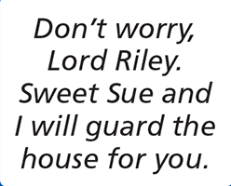
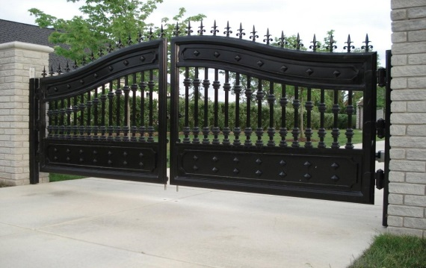
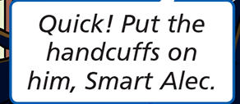
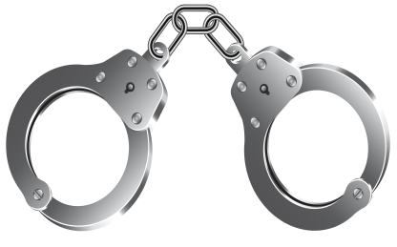
burglary /ˈbɜːɡləri/ enter a building illegally and steal things
guard /ɡɑːd/ keep watch
gate /ɡeɪt/ a part of a fence that opens like a door
handcuffs /ˈhændkʌfs/ two metal rings that lock around a prisoner’s wrist

