Slide 1
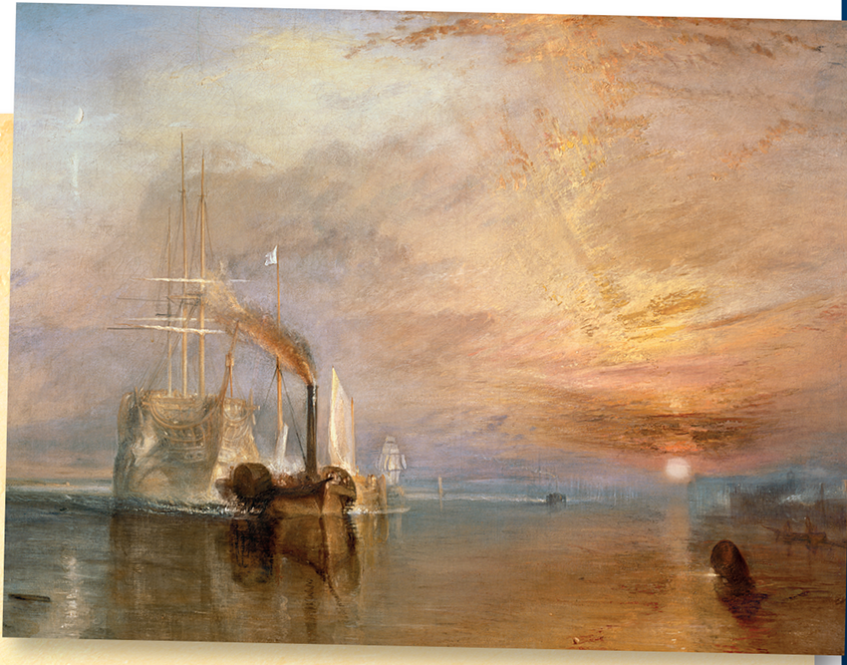
The Fighting Temeraire
Vocabulary

Slide 2
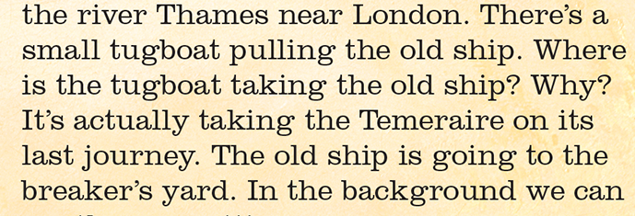
vote /vəʊt/ to express your opinion by raising your hand
tugboat /ˈtʌɡˌboʊt/ a boat with a powerful engine which pulls large boats (tegljač)
breaker’s yard
/ˈbreɪ.kəz ˌjɑːd/ a place where old ships/cars are taken apart (odlagalište starog željeza)

Slide 3
event /ɪˈvent/ anything that happens
sunset /ˈsʌnset/ the time when the sun goes down
pretty old – quite old

Slide 4
The Fighting Temeraire Retell the text.
Guidelines:
painted by William Mallord Turner
shows
voted
shows a real event
changed some of the details
loved
never sold
painted when he was
can see

