Slide 1
Robin Hood
Vocabulary

Slide 2
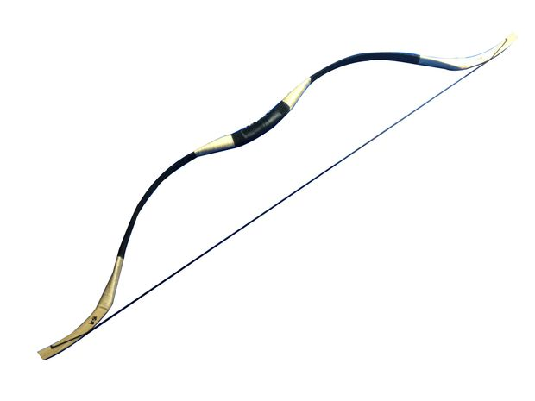
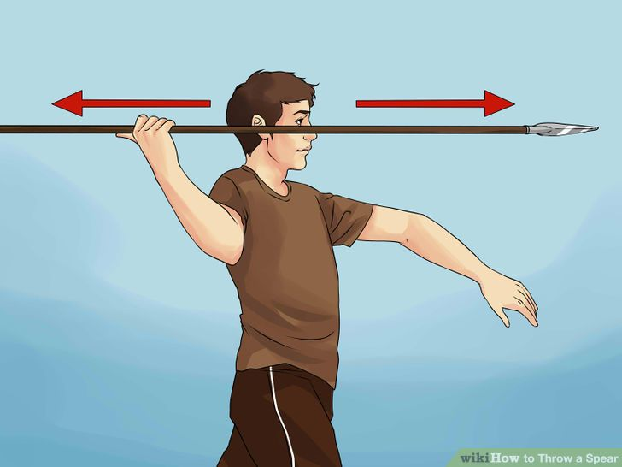
outlaw /ˈaʊtlɔː/ a person who does something illegal
a sword /sɔːd/
a bow /baʊ/
a spear
/spɪər/

Slide 3
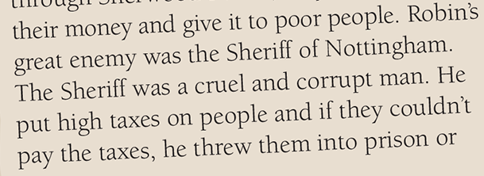
According to the legend
prema legendi
Merry Men /ˈmeri/ happy men
cruel /ˈkruːəl/ unkind, causing pain intentionally
corrupt /kəˈrʌpt/ dishonest
tax /tæks/ money paid to the government

Slide 4
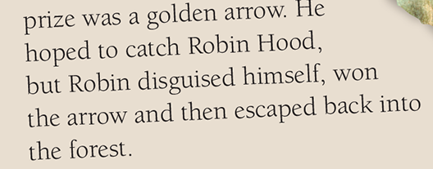
earl /ɜːl/ a man who belongs to a high social rank (grof)
a golden arrow
disguise /dɪsˈɡaɪz/ wear special clothes to hide your true appearance
escape /ɪˈskeɪp/ – run away

