Slide 1
King Arthur
Vocabulary

Slide 2


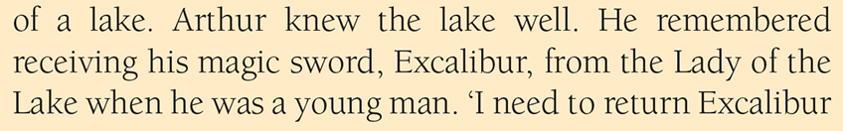
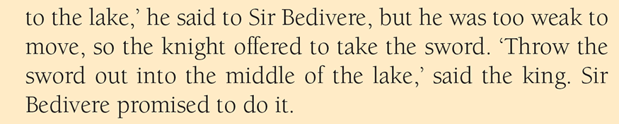
knight /naɪt/ a soldier who fought on a horse
wounded /ˈwuːndɪd/ injured
survive /səˈvaɪv/ to continue to live
receive /rɪˈsiːv/ to get
weak /wiːk/ not strong
promise /ˈprɒmɪs/ to say you will certainly do something
throw /θroʊ/ cast

Slide 3
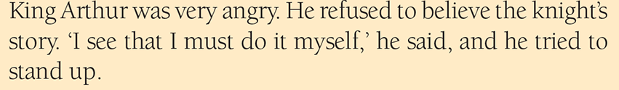
shore /ʃɔː/ a land along the edge of a lake or a sea
refuse /rɪˈfjuːz/ to say: ‘No’

Slide 4
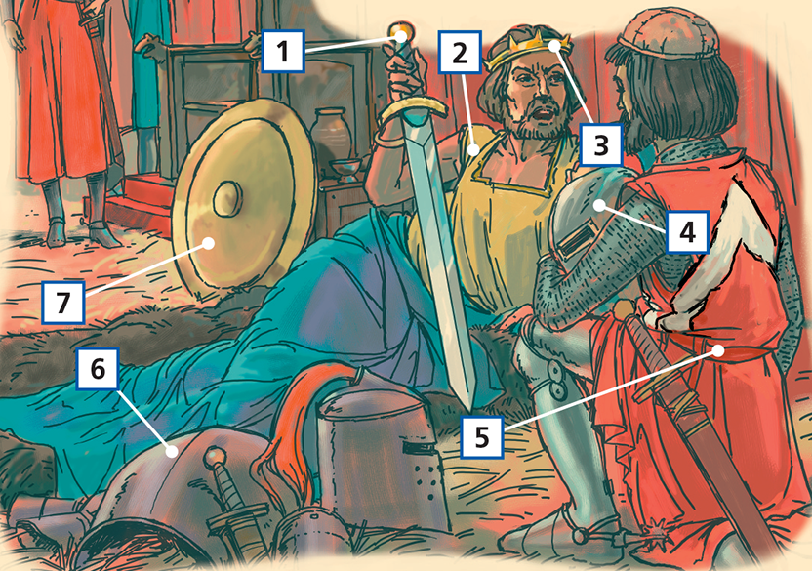
Label the picture
1 a sword
2 a king
3 a crown
4 a helmet
5 a knight
6 armour
7 a shield

