Slide 1
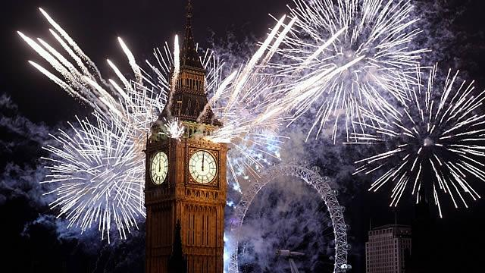
New Year traditions

Slide 2
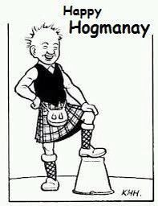
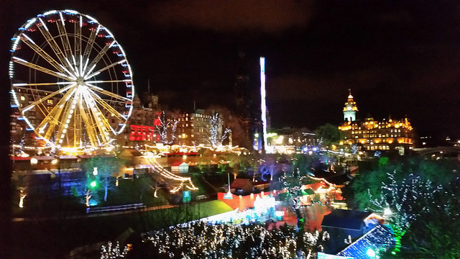
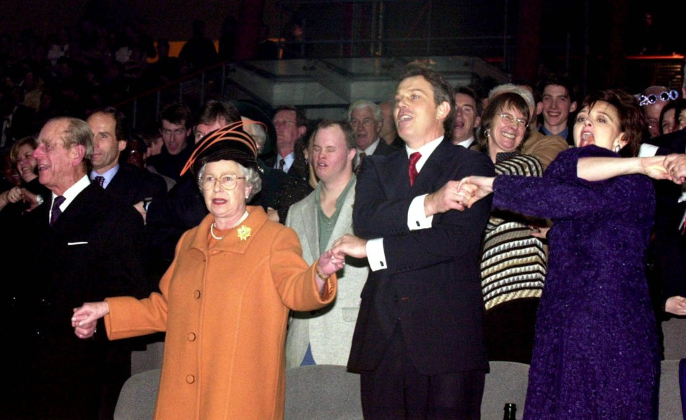
Scotland - Hogmanay
New Year’s Eve is called Hogmanay in Scotland. People have parties. At midnight they hold hands and sing the traditional song Auld Lang Syne which tells the story of friendship.
https://www.youtube.com/watch?v=WTCryF1J54Y

Slide 3
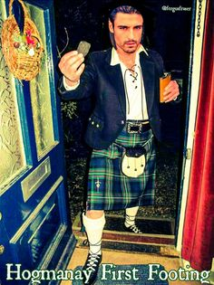
First Footing
In Scotland it is believed that if the first visitor after midnight is a dark-haired man, he will bring good luck. A fair-haired person, either male or female, brings bad luck. It is a custom in Scotland to take a piece of coal when you visit for the firs time in the New Year. It is also believed that it brings good luck.

Slide 4
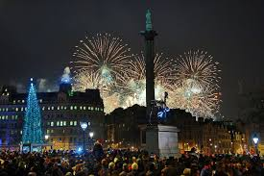
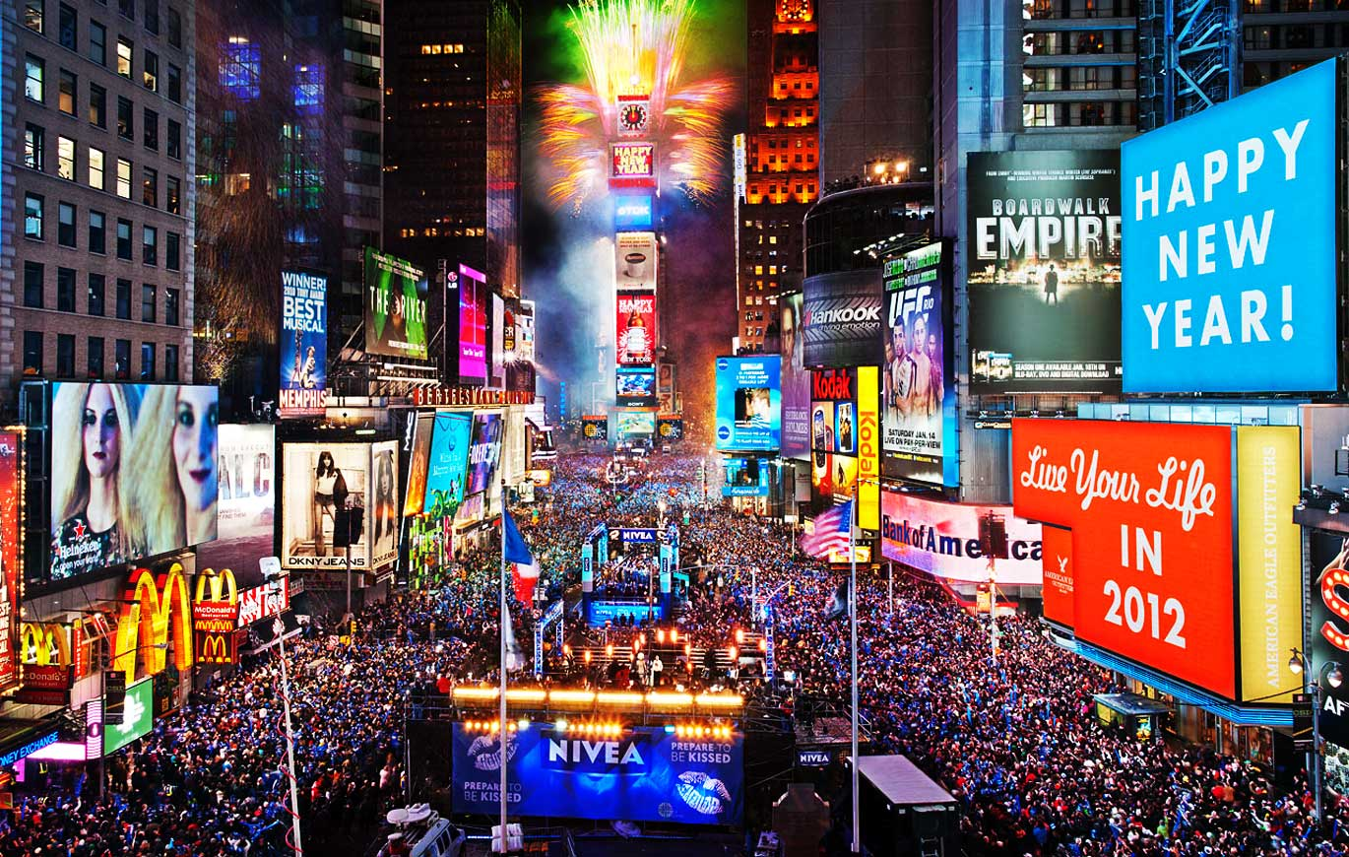
New Year in the UK and the USA
On 31st of December thousands of people gather at Trafalgar Square in London. New Yorkers meet at Times Square. They sing and dance and together count down the last seconds to the New Year.

Slide 5
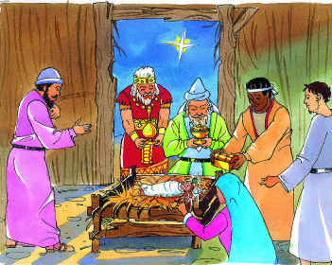
Christmas traditions
Most Christians celebrate Christmas on 25th December. They celebrate the birth of Jesus Christ who was born in a stable in Bethlehem. The three kings came and brought gifts to the baby Jesus.

Slide 6
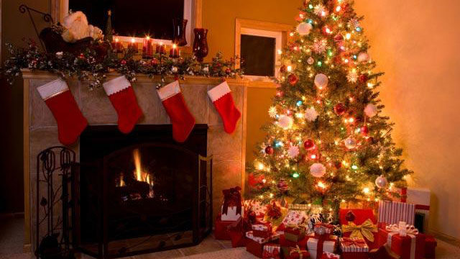
Santa Clause
On 24th December children put a Christmas stocking on the fireplace. On Christmas Day they find presents in their stockings. Children believe that Father Christmas or Santa Clause, as he is called in America, brings their presents. Father Christmas began as a man called Nicholas. He was the Bishop of Myra and lived in Asia Minor. The Bishop of Myra was a very good person who loved children and brought presents to poor children.

Slide 7
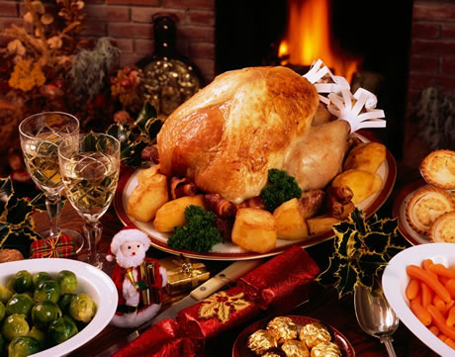
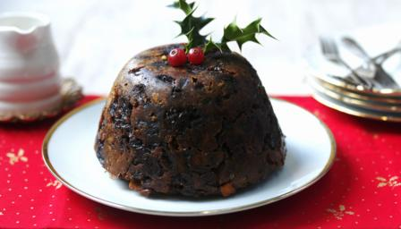
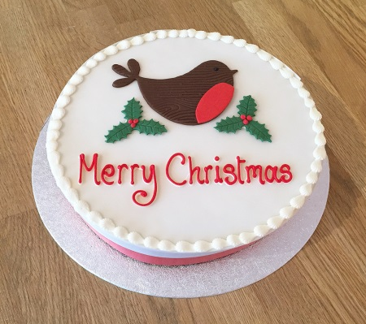
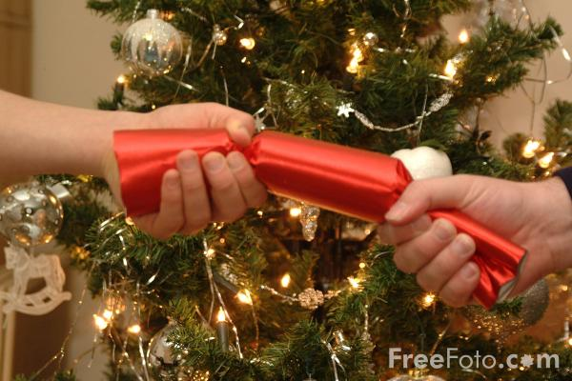
Christmas dinner
Traditionally, Christmas dinner is roast turkey with roast potatoes and other vegetables. After dinner they have Christmas pudding. Some people put a silver coin in it. The coin brings good luck to a person who finds it. In the evening people eat Christmas cake which is a fruit cake with icing. There are crackers on the Christmas dinner table, too. In pairs people pull the crackers to make a cracking sound. Every cracker has a riddle or a rhyme in it. So they read them and have fun.

Slide 8
QUIZ
1 Hogmanay is the Scottish word for New Year’s Eve.
2 Thousands of people gather at Times Square in London on New Year’s Eve.
3 If a tall man with blond hair is the first to enter the house after midnight, he brings good luck.
4 Auld Lang Syne is a song about friendship and old friends.
TRUE or FALSE
1 TRUE
2 FALSE
3 FALSE
4 TRUE

Slide 9
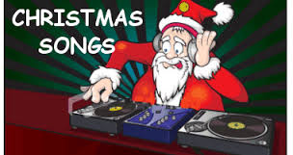

Slide 10
Some famousChristmas songs
Jingle Bells
Dashing through the snow
In a one horse open sleigh
O'er the fields we go
Laughing all the way
Bells on bob tails ring
Making spirits bright
What fun it is to laugh and sing
A sleighing song tonight
Oh, jingle bells, jingle bells
Jingle all the way
Oh, what fun it is to ride
In a one horse open sleigh
Jingle bells, jingle bells
Jingle all the way
Oh, what fun it is to ride
In a one horse open sleigh
Silent night
Silent night, holy night
All is calm, all is bright
Round yon Virgin Mother and Child
Holy Infant so tender and mild
Sleep in heavenly peace
Sleep in heavenly peace
Silent night, holy night!
Shepherds quake at the sight
Glories stream from heaven afar
Heavenly hosts sing Alleluia!
Christ, the Saviour is born
Christ, the Saviour is born
Silent night, holy night
Son of God, love's pure light
Radiant beams from Thy holy face
With the dawn of redeeming grace
Jesus, Lord, at Thy birth
Jesus, Lord, at Thy birth

Slide 11
Santa Claus Is Coming To Town
You better watch out
You better not cry
Better not pout
I'm telling you why
Santa Claus is coming to town
He's making a list
And checking it twice;
Gonna find out Who's naughty and nice
Santa Claus is coming to town
He sees you when you're sleeping
He knows when you're awake
He knows if you've been bad or good
So be good for goodness sake!
O! You better watch out!
You better not cry
Better not pout
I'm telling you why
Santa Claus is coming to town
Santa Claus is coming to town
White Christmas
I'm dreaming of a white Christmas
Just like the ones I used to know
Where the treetops glisten,
and children listen
To hear sleigh bells in the snow
I'm dreaming of a white Christmas
With every Christmas card I write
May your days be merry and bright
And may all your Christmases be white
I'm dreaming of a white Christmas
With every Christmas card I write
May your days be merry and bright
And may all your Christmases be white

Slide 12
Last Christmas
Last Christmas, I gave you my heart
But the very next day, You gave it away
This year, to save me from tears
I'll give it to someone special
Last Christmas, I gave you my heart
But the very next day, You gave it away
This year, to save me from tears
I'll give it to someone special
Once bitten and twice shy
I keep my distance but you still catch my eye
Tell me baby do you recognise me?
Well it's been a year, it doesn't surprise me
(Happy Christmas!) I wrapped it up and sent it
With a note saying "I Love You" I meant it
Now I know what a fool I've been
But if you kissed me now I know you'd fool me again
Chorus
(Oooh. Oooh Baby)
A crowded room, friends with tired eyes
I'm hiding from you and your soul of ice
My God I thought you were someone to rely on
Me? I guess I was a shoulder to cry on
A face on a lover with a fire in his heart
A man undercover but you tore me apart
Oooh Oooh
Now I've found a real love you'll never fool me again
Chorus
A face on a lover with a fire in his heart
(Gave you my heart)
A man undercover but you tore me apart
Next year
I'll give it to someone, I'll give it to someone special
special
someone
someone
I'll give it to someone, I'll give it to someone special
who'll give me something in return
I'll give it to someone
hold my heart and watch it burn
I'll give it to someone, I'll give it to someone special
I've got you here to stay
I can love you for a day
I thought you were someone special
gave you my heart
I'll give it to someone, I'll give it to someone
last christmas I gave you my heart
you gave it away
I'll give it to someone, I'll give it to someone

Slide 13
Jingle Bells
htps://www.youtube.com/watch?v=eQ34DSTjsLQ
Silent Night
https://www.youtube.com/watch?v=jA33qKpzkl0
White Christmas
https://www.youtube.com/watch?v=CcEsypy6tIE
Last Christmas
https://www.youtube.com/watch?v=E8gmARGvPlI
Santa Claus is Coming to Town
https://www.youtube.com/watch?v=2IMKGY8iC64
We Wish You a Merry Christmas
https://www.youtube.com/watch?v=C41q5YLnF10

