Slide 1
What is a balanced diet?
Describe your diet.

Slide 2
energy
fatty acids (omega 3)
2-5%
50%
energy
15-18%
grow
30%
vitamins and
minerals

Slide 3
Complex carbohydrates
should make up 50%
give energy

Slide 4
Fruit and vegetables
should make up 30%
a lot of vitamins and minerals

Slide 5
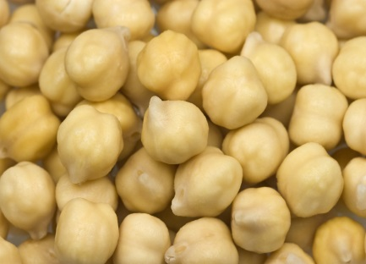
Protein
help - grow
chicken peas

Slide 6
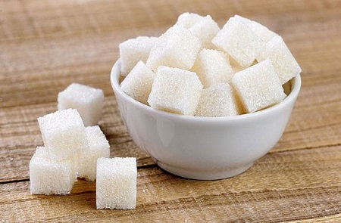
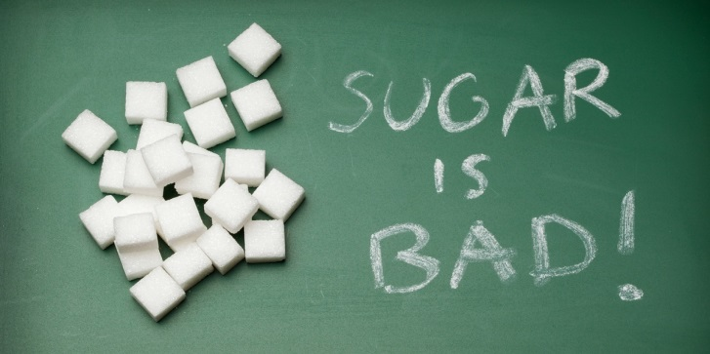
Fat and sugar
gives energy
provides fatty acids
BUT

