Slide 1
Vitamins and minerals
Vocabulary

Slide 2
water-soluble
/ˈwɔːtəsɒljəbəl/ it can dissolve in water
store /stɔː/ to keep something (for use in the future)
potassium /pəˈtæsiəm/ kalij

Slide 3
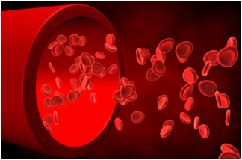
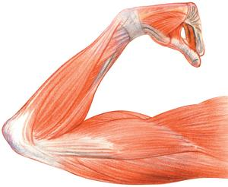
blood cells
oxygen /ˈɒksɪdʒən/
muscle /ˈmʌsəl/

Slide 4
absorb /əbˈzɔːb/ to take something gradually
liver /ˈlɪvər/ jetra
lung /lʌŋ/ plućno krilo
salmon /ˈsæmən/ losos

