Slide 1
VITAMINS
A B C D E F

Slide 2
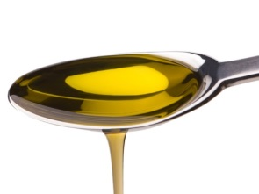
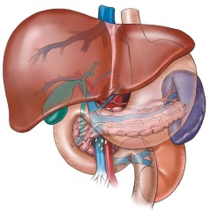
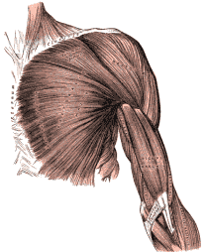
B and C
A, D and E
fat-soluble
They dissolve in fat.
store /stɔːr/ keep something for use in the future
lungs /lʌŋz/
liver /ˈlɪvər/
muscle/ˈmʌsəl/
water-soluble
/ˈwɔːtəsɒljəbəl/ - They dissolve in water.

