Slide 1
Sweet Sue has the last laugh
Vocabulary

Slide 2
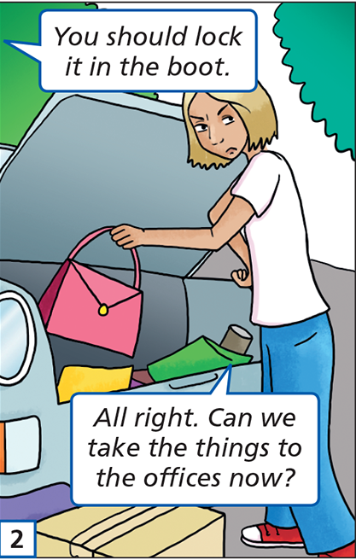
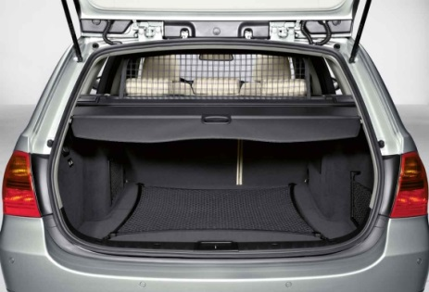
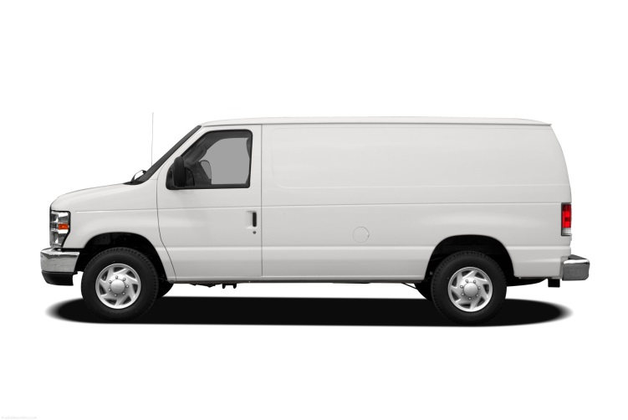
boot /buːt/ a space at the back of the car
van /væn/ a car used for carrying goods

Slide 3
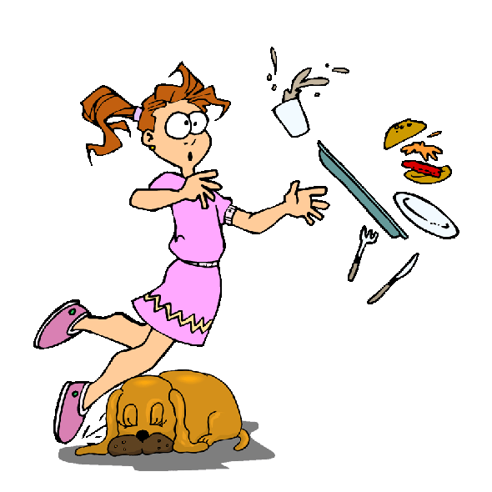
stairs /steərz/ a set of steps
trip over - to stumble on something

Slide 4
bend over – to move your body downwards

Slide 5
bet /bet/– to be certain
advice /ədˈvaɪs/ an opinion that someone offers in order to help

