Slide 1
Sports events
Vocabulary

Slide 2
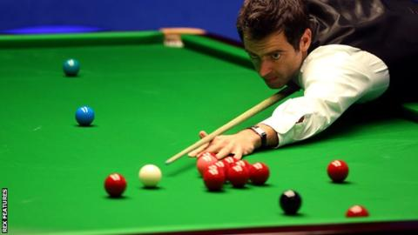
spectator sports – sports which people like watching
on the calendar- the time is determined
snooker
The Premiership-professional league

Slide 3
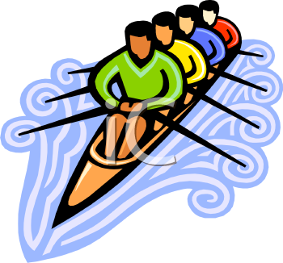
crew /kruː/ a group of people who work together
rowers
ordinary people /ˈɔːdənəri/
usual, not different from other people
raise money – collect money

Slide 4
suburb /ˈsʌbɜːb/ the outer area of a town

