Slide 1
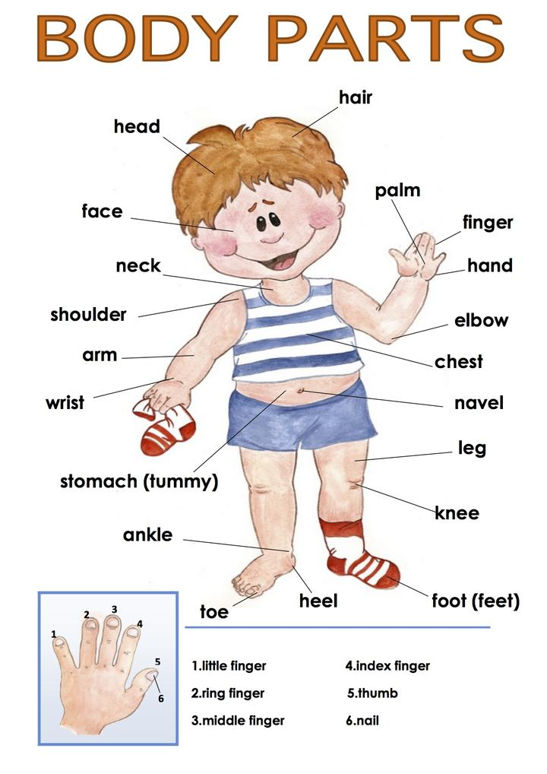

Slide 2
1 hair
2 head
3 ear
4 eye
5 nose
6 mouth
7 teeth
8 arm
9 hand
10 finger
11 stomach
12 leg
13 foot
14 toe

Slide 3
1 forehead
2 lips
3 tongue
4 neck
5 throat
6 wrist
7 bottom
8 knee
9 shin
10 calf
11 ankle
12 heel
13 thigh
14 elbow
15 chest
16 shoulder
17 palm
18 thumb

Slide 4
1 nail
2 palm
3 chin
4 cheek
5 eyelid
6 eyebrow

Slide 7
Fill in the blanks.
1 Your..........is at the back of your foot.
2 Your ........ is between your foot and your leg.
3 The top part of your leg is your ...........
4 The back of the bottom part of your leg is your .....
5 The front of the bottom part of your leg is your.......
6 Your ...... is between your thigh and your shin.
7 You sit on your .....
8 Your .... is between your eyes and your hair.
9 You use your t..... and your l..... when you speak.
10 Your tongue is in your.....
11 Your ..... are around your mouth.
12 On each hand you’ve got four...... and one .......
13 The inside part of your hand is your......
14 Your ...... is where your hand bends.
15 The top front part of your body is your....
16 Your ..... is between your head and your chest.
17 The front of your neck is your.....
18 Your..... is in the middle of your arm.
19 Your.....is between your arm and neck.

Slide 8
Answers
1 heel
2 ankle
3 thigh
4 calf
5 shin
6 knee
7 bottom
8 forehead
9 tongue ... lips
10 mouth
11 lips
12 fingers... thumb
13 palm
14 wrist
15 chest
16 neck
17 throat
18 elbow
19 shoulder

Slide 9
You and your body
People who do exercises are fit.
fit /fɪt/ healthy and strong
You don’t have to do strenuous exercise.
strenuous /ˈstrenjuəs/ hard (iscrpljujuće)
Fill yourself up with healthy food.
fill up – eat
People who smoke live, on average 10 years less than smokers.
on average /ˈævərɪdʒ/ u prosjeku

Slide 10
People who sunbathe a lot are more likely to get skin cancer.
sunbathe /ˈsʌnbeɪð/ to lie in the sun
cancer /ˈkænsər/ a serious disease (rak)
Wear sunscreen in hot, sunny
weather.
sunscreen /ˈsʌnskriːn/ you put it on your skin to protect it from the sun

Slide 11
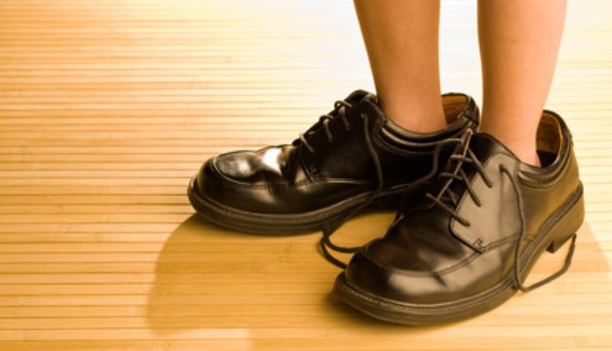
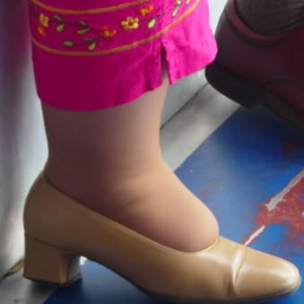
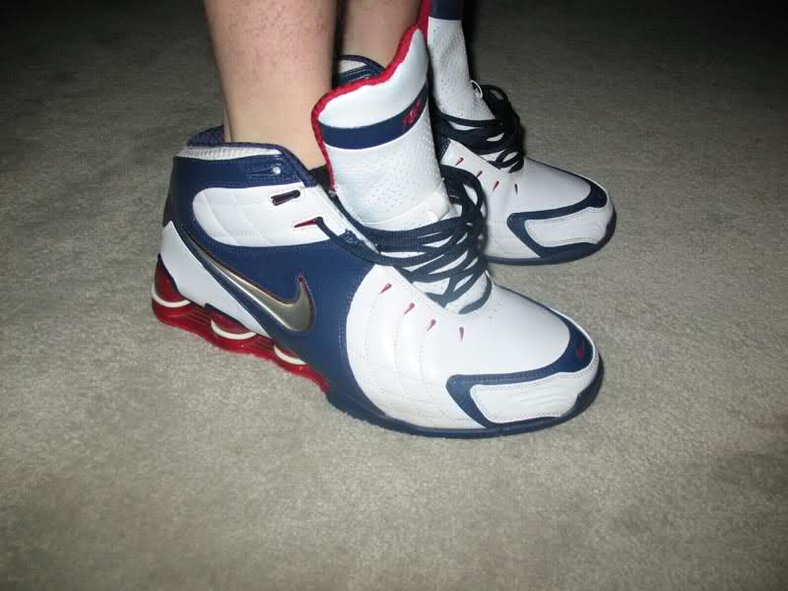
Wear shoes that fit properly.
fit - to be the right size
Shoes that are too tight or too loose will damage your feet and posture.
posture /ˈpɒstʃər/ a position of your body
tight/taɪt/ too small, uncomfortable
loose /luːs/ not fitting closely to the body, too big

