Slide 1
The story of England

Slide 2
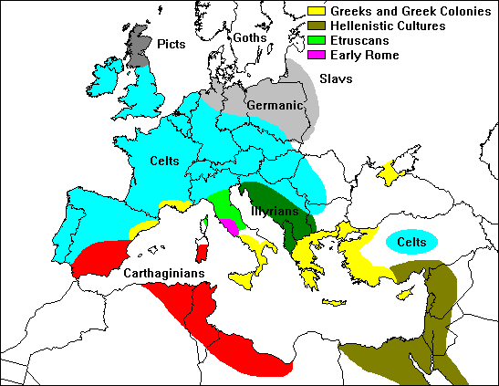
In 600 BC the Celts arrived to Britain from Belgium.

Slide 3
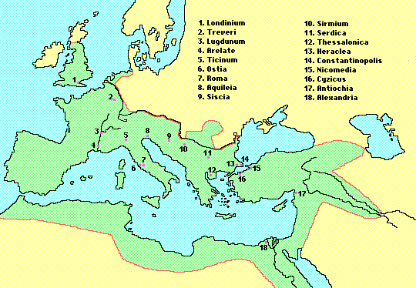
In the 1st century AD the Romans conquered Britain and named it Britannia.

Slide 4
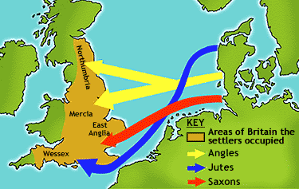
The Angles, the Jutes and the Saxons came to Britain from the north of Germany in the 4th century.

Slide 5
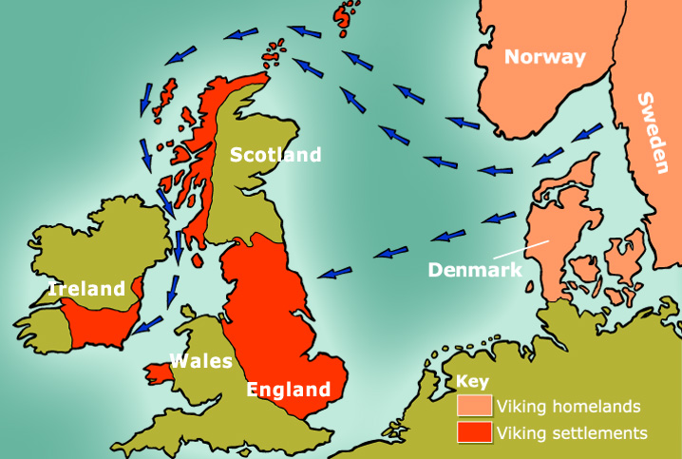
The Vikings from Scandinavia attacked Britain in the 8th century

Slide 6
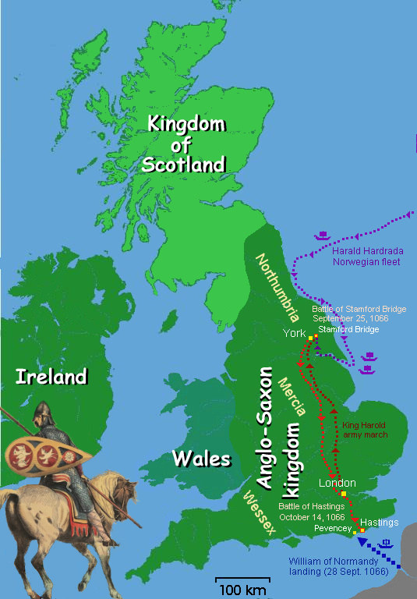
The Normans, the people from the north of France, started ruling England after the battle of Hastings in 1066. William of Normandy became King William I.

Slide 7
INVADERS | WHEN? | WHERE FROM?
The Celts | around 600 BC | Belgium
The Romans | in 43 AD | Europe (the Roman Empire)
The Anglo-Saxons | in the 4th century | the north of Germany
The Vikings | in the 8th century | Denmark and Norway
The Normans (Duke William of Normandy) | in 1066 | Normandy (France)

