Slide 1
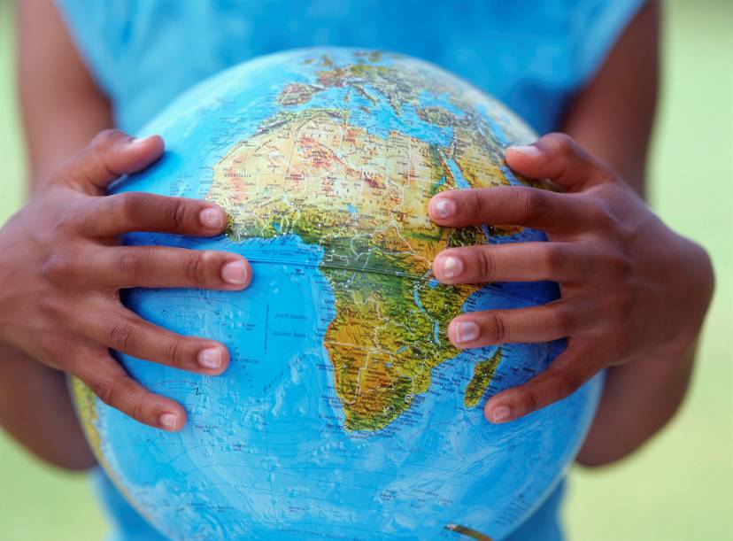
The European Day of Languages
26the September

Slide 2

Which are the four most widely spoken languages around the world?
Chinese
English
Hindustani
Spanish

Slide 3
The world’s population is roughly 6 billion people.

Slide 4

One and a quarter billion people speak Chinese

Slide 5

550 million speak English

Slide 6
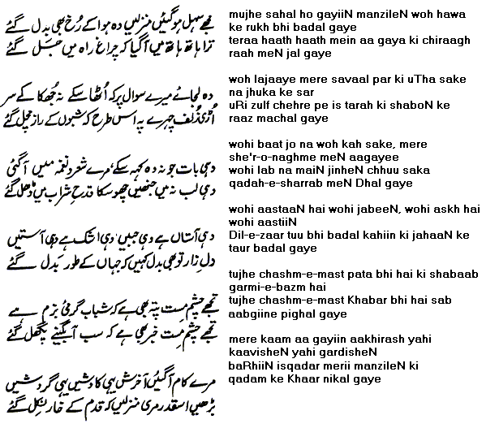
Hindustani speakers number 500 million

Slide 7

Spanish is spoken by 450 million people worldwide

Slide 8
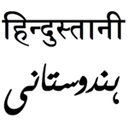
So just under half the world’s population can speak one of those four languages

Slide 9
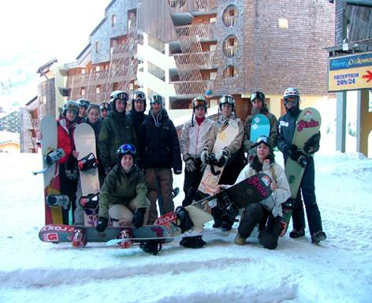
In Sweden, the Netherlands and Denmark, more than 85% of citizens can express themselves in another language.
That’s nearly nine in every ten people.

Slide 10
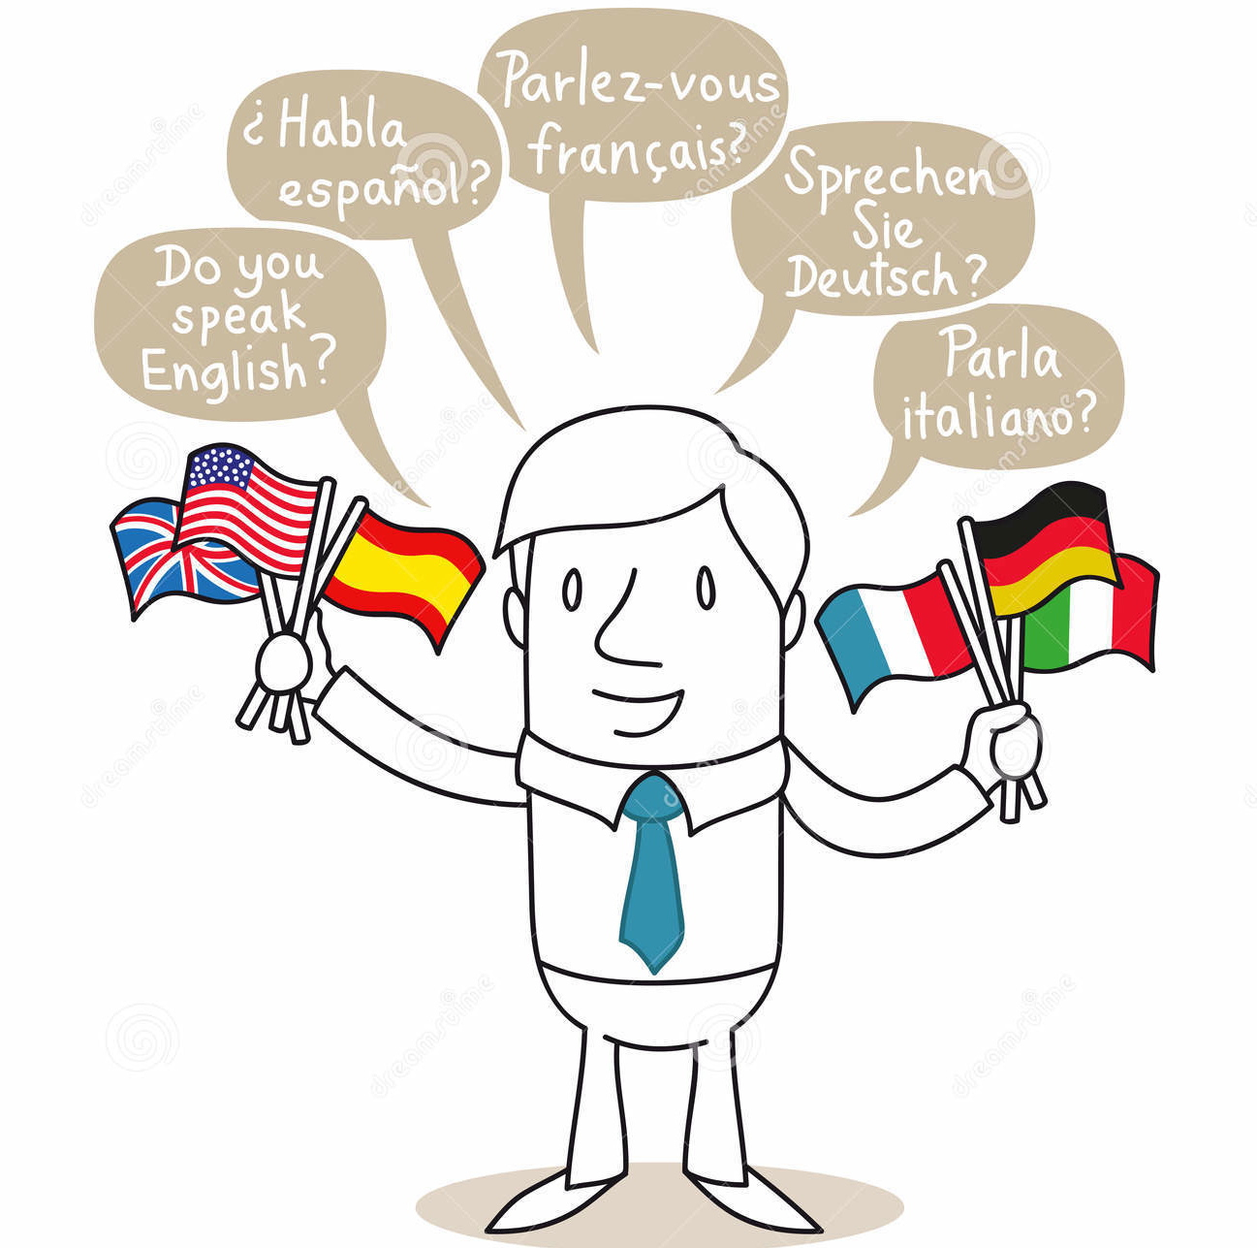
In Croatia 78% of citizens can speak at least one foreign language.
About 60% of citizens can speak English.
Other popular foreign languages are Italian and German

Slide 11
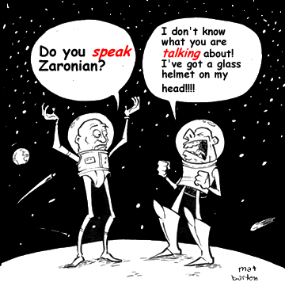
In Britain two out of three people (66%) can only speak English.

Slide 12
…which means 1 out of 3 can speak another language
Notes:
So how does this school compare? How many students are learning one foreign language? (Show of hands.) Two? Three?

Slide 13
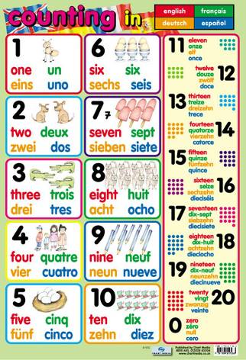
What tips do you have for learning languages?
Visit the country.
Get a penpal or ePal.
listen to CDs and music.
Watch films & DVDs.
Try websites.
Notes:
ask the children what they can suggest

Slide 14
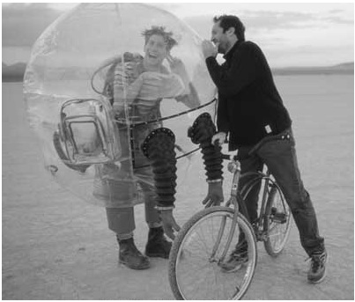
People will appreciate when you make the effort to speak their language

Slide 15

That’s why we are celebrating the European Day of Languages today.

Slide 16
