Slide 1
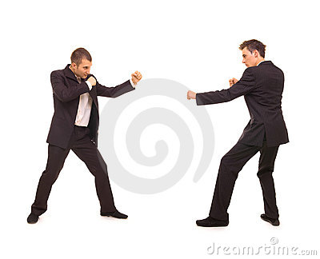
We used to be rivals
Vocabulary

Slide 2
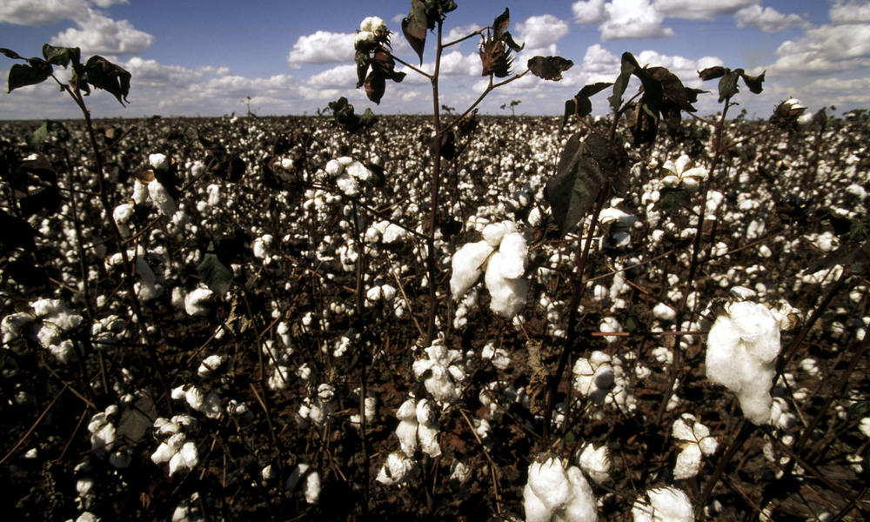
They used to be rivals.
rival /ˈraɪvəl/ a person who competes in order to surpass others
We share one big office.
share /ʃeər/ to use something at the same time
I used to wear nice cotton tops.
used to /ˈjustu/ done in the past, but no longer done
cotton /ˈkɒtən/ made from the cotton plant
top /tɒp/ a piece of clothing worn above the waist

Slide 3
She didn’t use to put things away.
put away – to put something where it belongs
I used to be a builder.
builder /ˈbɪldər/ a person who makes buildings

