Slide 1
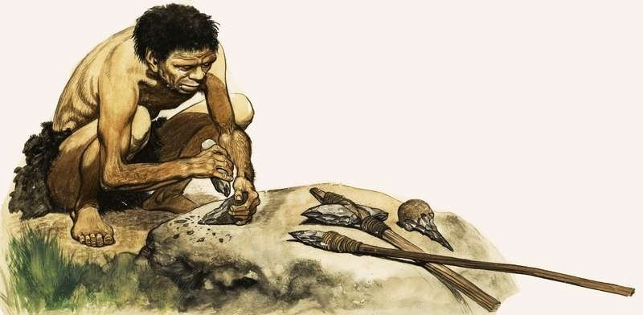
Describe the Stone Age
(Use the Past Simple)

Slide 2
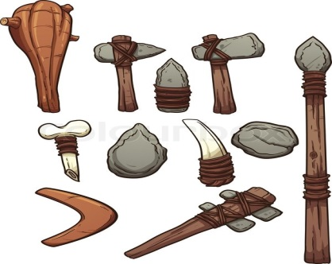
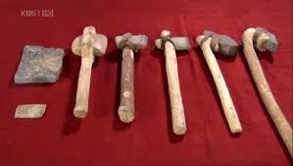
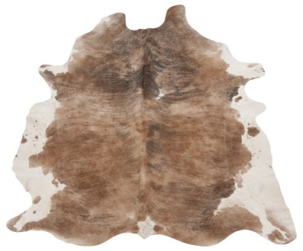
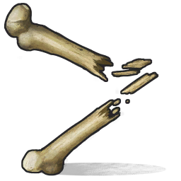
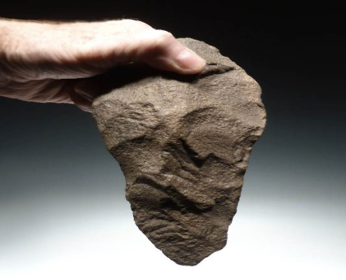
stone weapons and tools
wood, leather and animal bones
pick things when they found them
the Old Stone Age and the New Stone Age

Slide 3
The Old Stone Age
not in one place
follow and hunt animals
primarily hunters

Slide 4
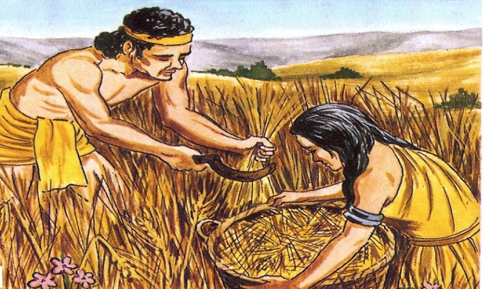
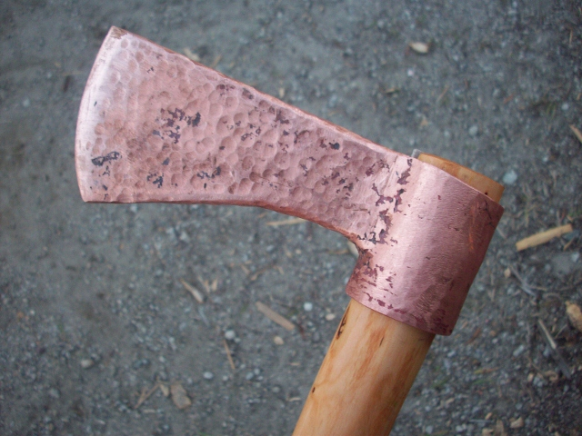
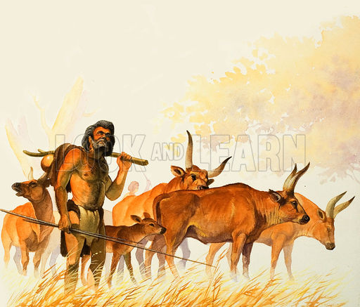
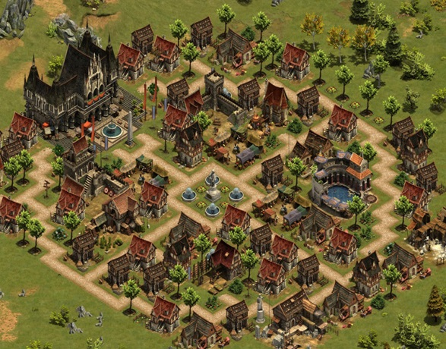
The New Stone Age
discover farming in the Middle East around 4000 BC
grow corn in the fields
keep animals like cows, sheep and goats
used copper tools and weapons
start to build villages and towns
Ӧtzi – a farmer

Slide 5
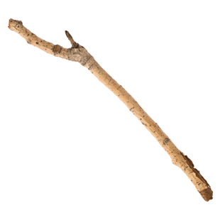
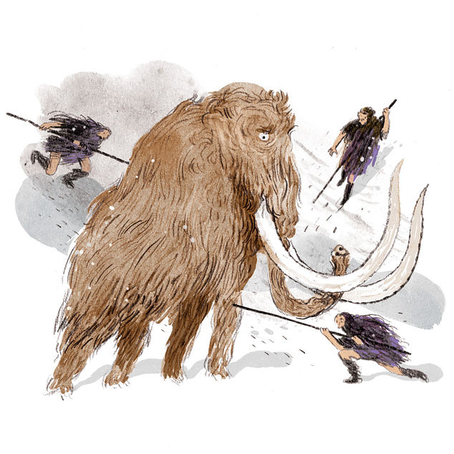
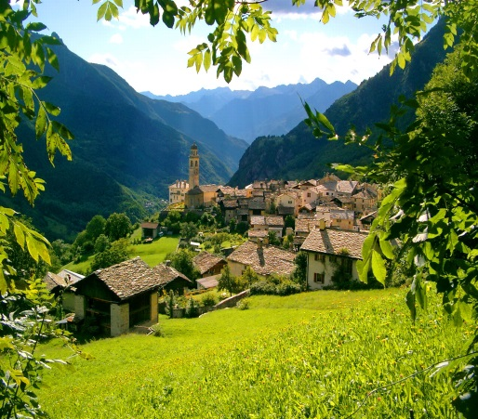
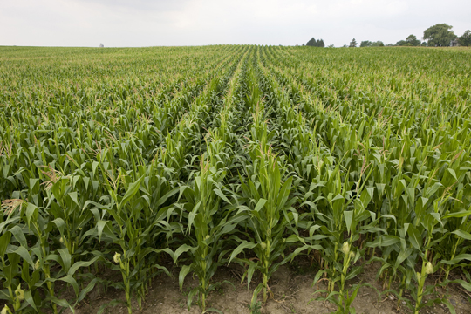
village /’vılıdȜ/ a group of houses that is smaller than a town
field /fi:ld/ land used for growing crops
stick /stik/ a thin piece of wood
hunter /’hᴧntә/ a person that hunts animals
weapon /ˈwep.ən/ any object used in war

Slide 6
THE PAST SIMPLE TENSE yesterday, last week, two years ago, in 1990 (We know exactly when somtehing happened.)
REGULAR VERBS. IRREGULAR VERBS Inf. + d, ed they change forms (2nd column) I played I bought You played You bought He played He bought She played She bought It played It bought We played We bought You played You bought They played They bought I didn't play I didn't buy Did you play? Did you buy?

