Slide 1
The Iceman
Vocabulary

Slide 2
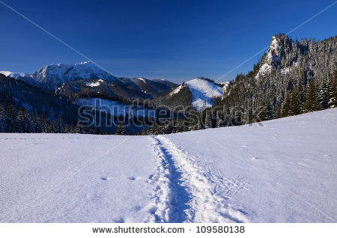
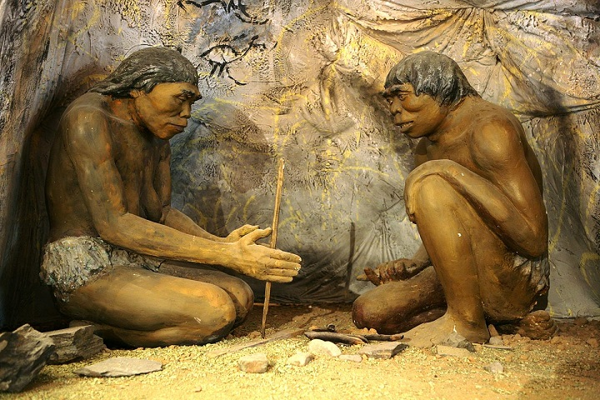
They were walking along the path.
path /pɑːθ/ a route or a track
They were looking at a man from the Stone Age.
Stone Age /ˈstəʊnˌeɪdʒ/
the early period in human history
3000 BC /ˌbiːˈsiː/ before Christ (before Jesus Christ was born)

Slide 3
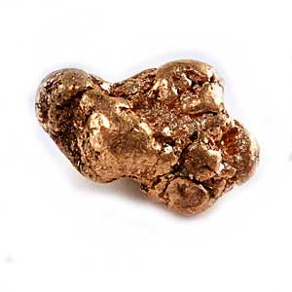
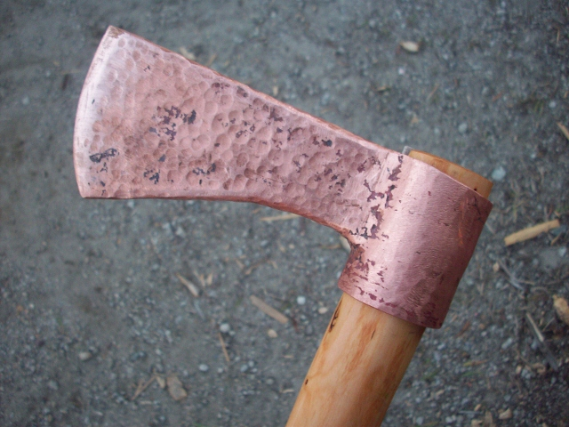
Scientists found pieces of corn in his clothes.
corn /kɔːn/ maize
The Iceman was carrying a copper axe.
copper / ˈkɒpər/ a reddish brown metal
axe /æks/ a tool used for cutting wood

Slide 4
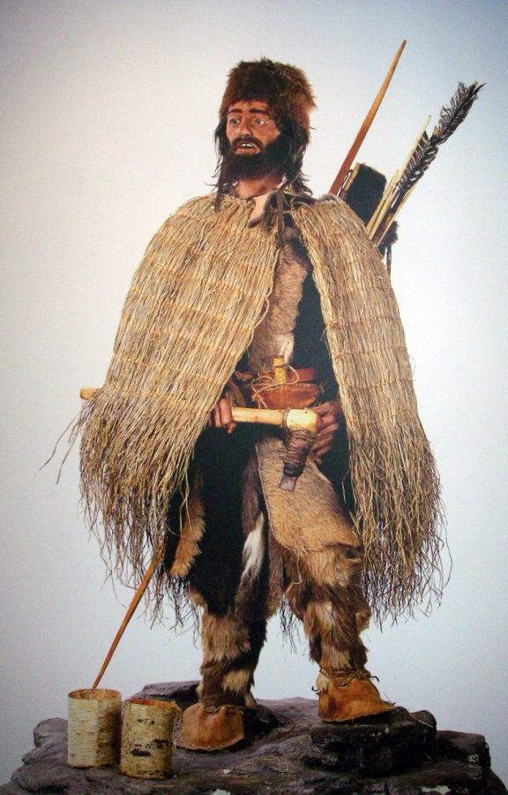
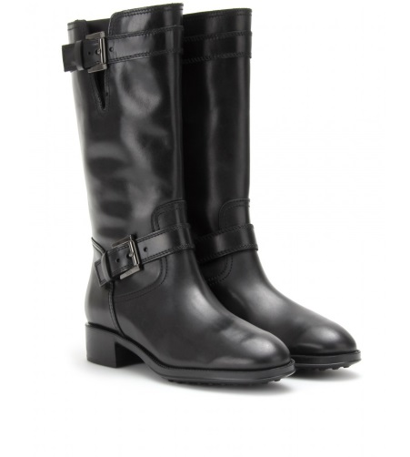
The Iceman was also carrying a bow and arrows.
He was wearing a waterproof cloak and leather boots.
waterproof cloak /ˈwɔːtəpruːf ‘kləʊk/ a coat without sleeves which protects you from rain
leather boot /ˈleðər ‘buːt/ shoes made of animal skin which cover the lower part of the leg

Slide 5
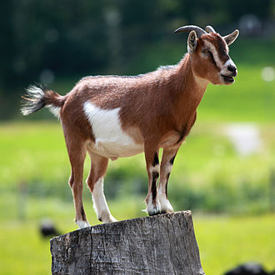
Stone Age people were very sophisticated.
sophisticated /səˈfɪstɪkeɪtɪd/ opposite of primitive (napredan)
an archaeologist /a:ki'ɔləʤist/ a person who studies archaeology
a goat /gəut/ an animal similar to a sheep
a tool /tu:l/ a piece of equipment which you use to make something

Slide 6
Describe the Iceman
between 3350 BC and 3100 BC
northern Italy
46 years old
1.6m tall
eyes and hair
a farmer (pieces of corn)
a copper axe, a bow and arrows, a knife and wooden tools
warm clothes: a waterproof cloak and leather boots
sophisticated

