Slide 1
Describing clothes
Vocabulary

Slide 2
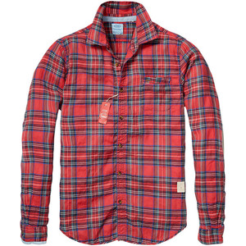
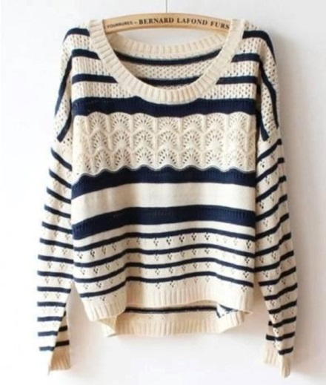
a plain T-shirt
a checked shirt
a striped pullover

Slide 3
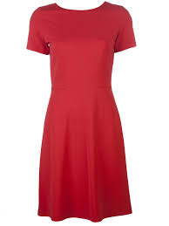
a long – sleeved blouse
a short – sleeved dress
tight trousers

Slide 4
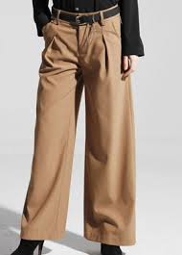
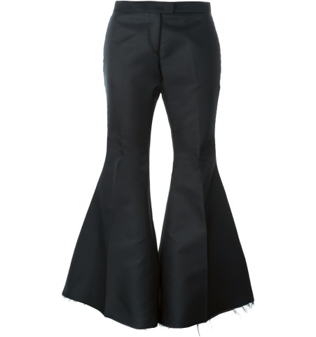
loose trousers
flared trousers
baggy jeans

Slide 5
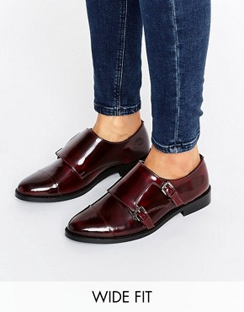
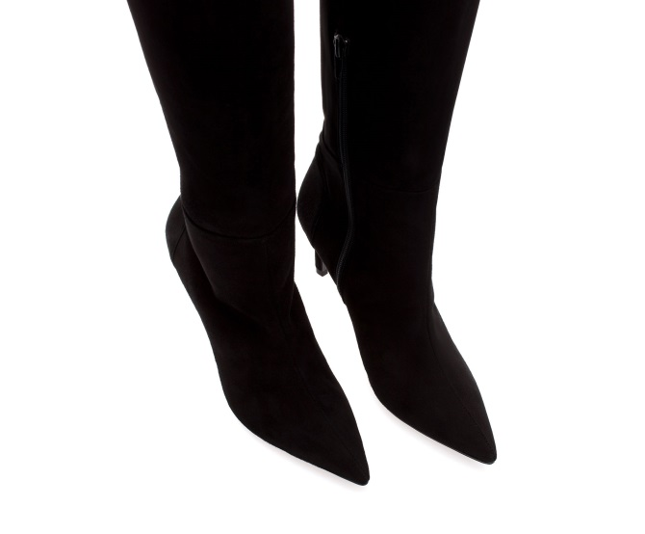
high – heeled sandals
flat shoes
pointed boots

