Slide 1
The United Kingdom *

Slide 2
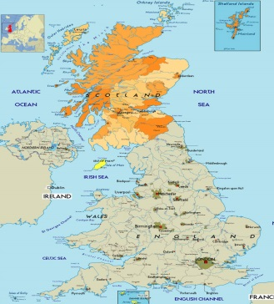
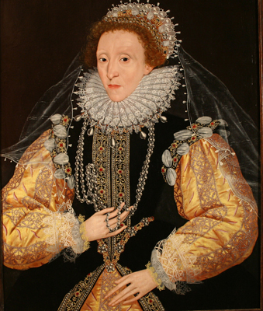
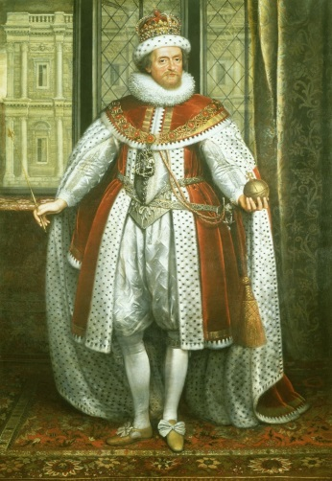

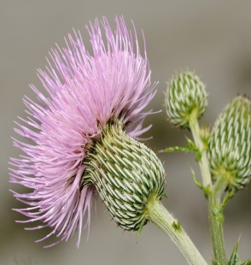
Scotland
In the past Scotland and England were separate countries.
In 1603 the English Queen Elizabeth I died and her cousin, James the King of Scotland, became the king of England.
The thistle is the symbol of Scotland

Slide 3
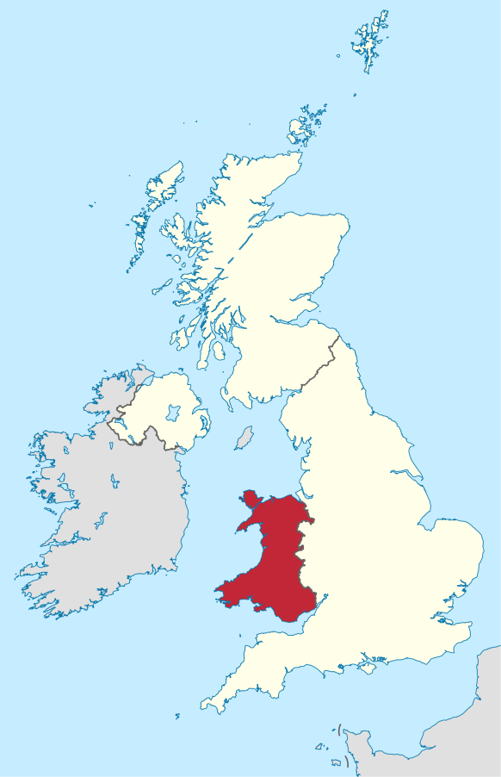
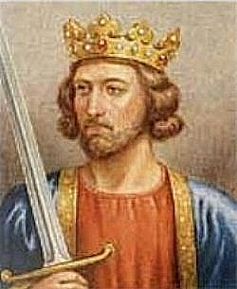
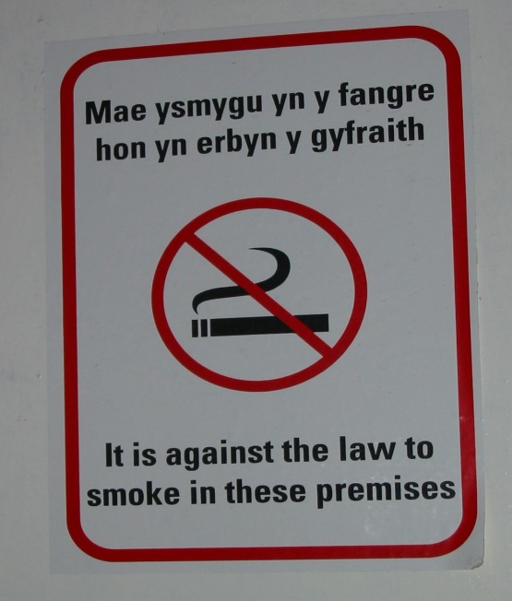
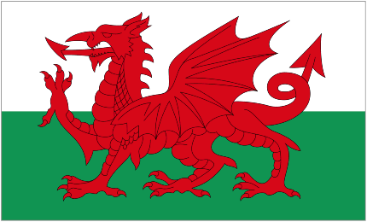
Wales
Edward I conquered Wales in the 13th century.
Since then the eldest son of the monarch is always the Prince of Wales.
Many people in Wales speak two languages: English and Welsh.
All children learn Welsh at school and signs must be in Welsh and English.

Slide 4
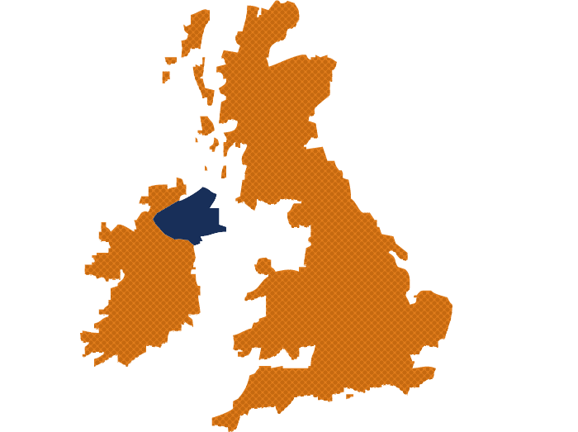
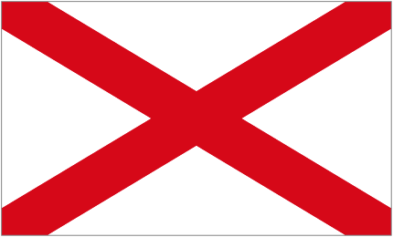
Ireland
Elizabeth I conquered Ireland in the 16th century.
In the 1920s the south became an independent country (the Republic of Ireland), but Northern Ireland is still a part of the UK.

Slide 5

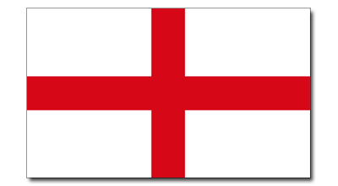
The Union Jack
It is three flags in one.
Scotland
Ireland
England

