Slide 1
The United Kingdom
Talk about the United Kingdom.

Slide 2
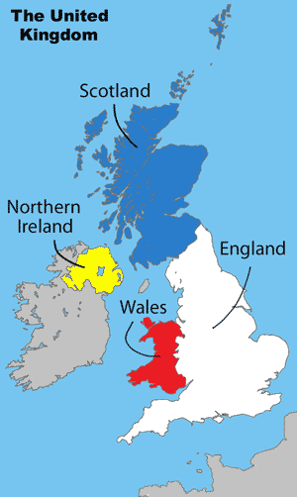
The United Kingdom
Edinburgh
Belfast
Dublin
London
Cardiff

Slide 3
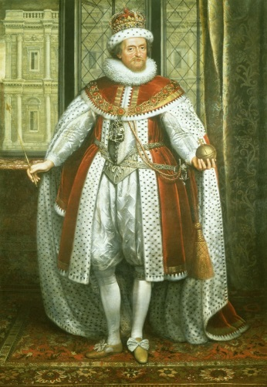
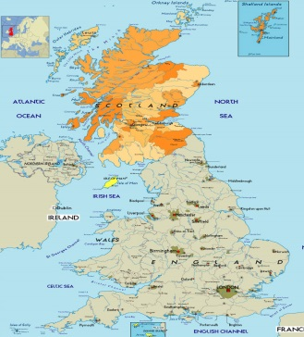
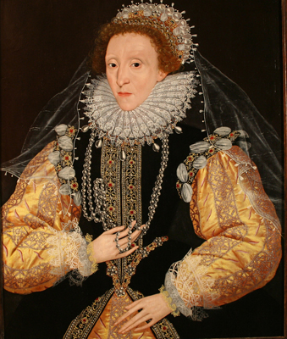


Scotland
in 1603
James, the king of Scotland

Slide 4
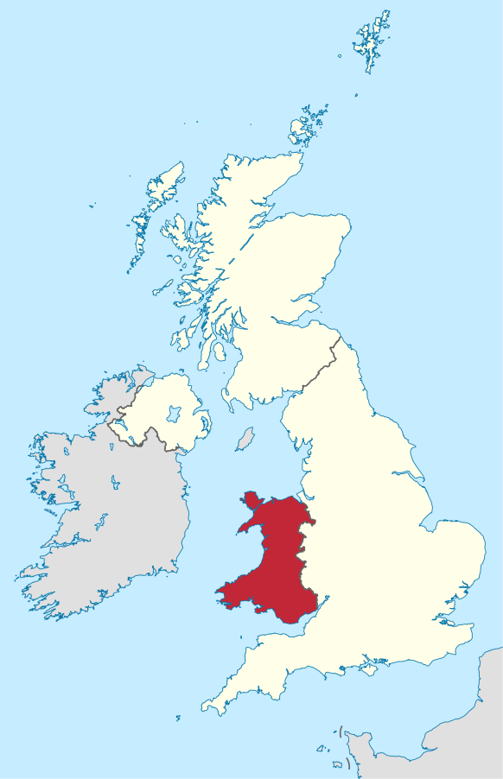
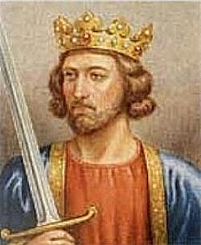
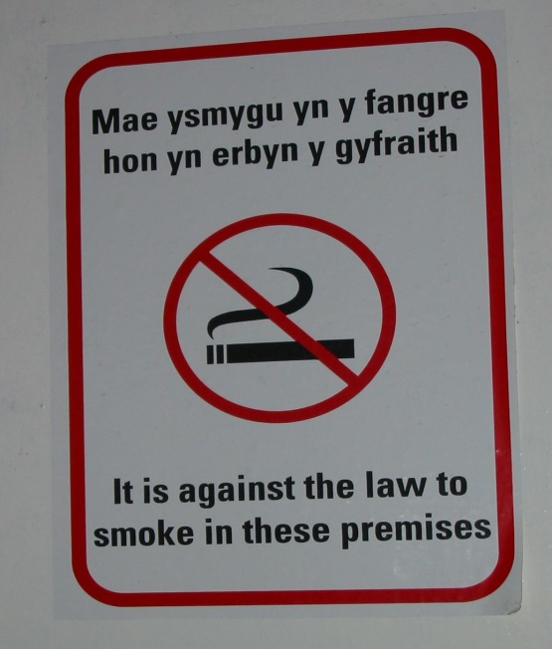

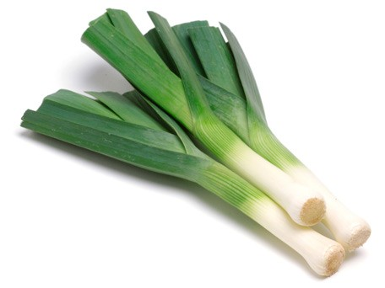
Wales
- the English king, Edward I
- in the 13th century
leek

Slide 5
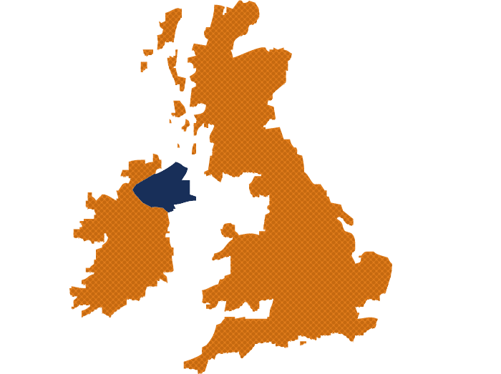

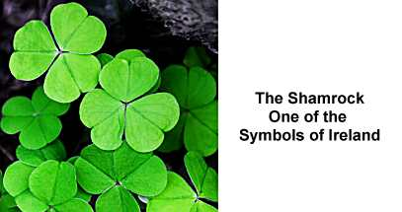
Ireland
- Elizabeth I – in the 16th century
- in the 1920s

Slide 6


The Union Jack

