Slide 1
Lord Bao and the Stone
https://www.youtube.com/watch?v=Z-4m_YK62Vk

Slide 2
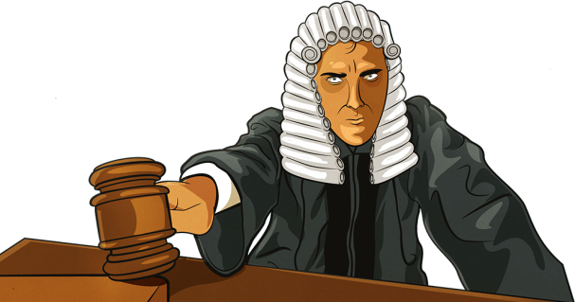
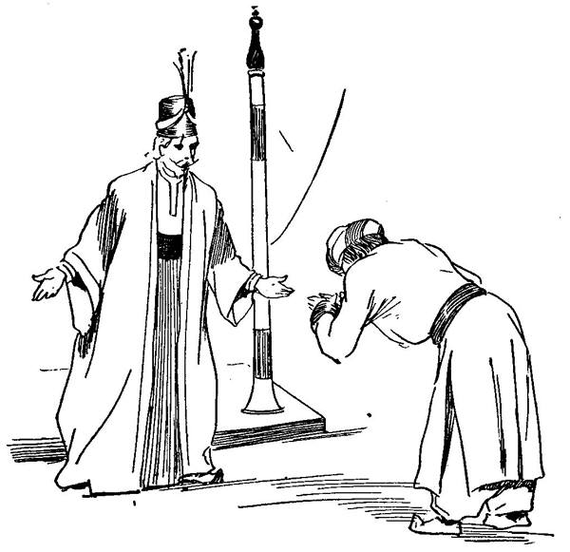
Vocabulary
Lord Bao is a judge.
People love him because he is fair.
Lord Bao and his servant see a boy in the town.
judge /dʒʌdʒ/ a person who decides how to punish guilty people
fair /feə/ treating someone in a way that is right.
servant /ˈsɜːvənt/ a person who works for another person

Slide 3
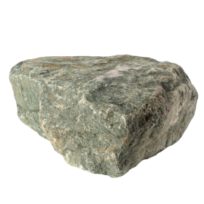
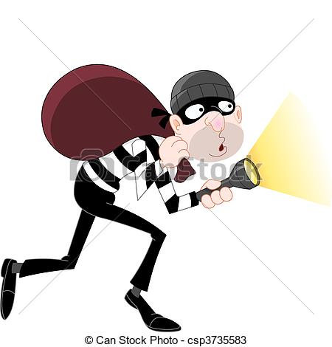
The boy puts his head on the stone and has a sleep.
Lord Bao says: ’This stone is the thief.’
The people in the street laughed and said: ‘Lord Bao is mad.’
stone /stəʊn/ a hard substance found in the ground
thief /θiːf/ a person who steals
laugh /lɑːf/ you do it when you are happy
mad /mæd/ silly or stupid

Slide 4
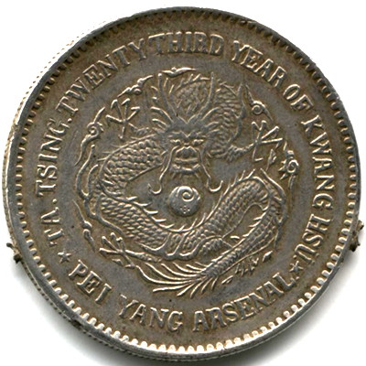

‘I must fine everyone of you a one cent coin for that.’
The boy is an oil seller.
fine /faɪn/ pay some money as a punishment
coin /kɔɪn/ a round piece of metal used as money
oil seller /ˈselər/ a person who sells oil

