Slide 1
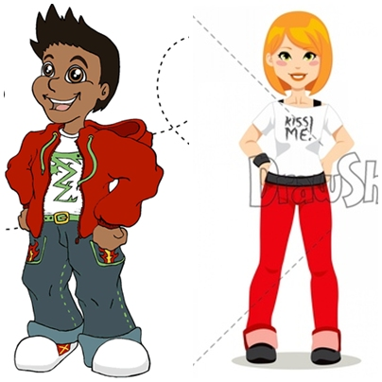
Write: her, his, sandals, jacket, black, T-shirt, shoes, shorts
_____ jeans are blue.
_____ T-shirt is black and white.
_____ jeans are red.
Her ______are black.
His ______ is white and green.
______ trainers are white.

Slide 2
Answers
His jeans are blue.
Her T-shirt is black and white.
Her jeans are red.
Her shoes are black.
His T-shirt is white and green.
His trainers are white.

