Slide 1
A trip to London

Slide 2
London is the capital city of the United Kingdom. It is on the River Thames. It is full of excting sights. You should visit it.

Slide 3
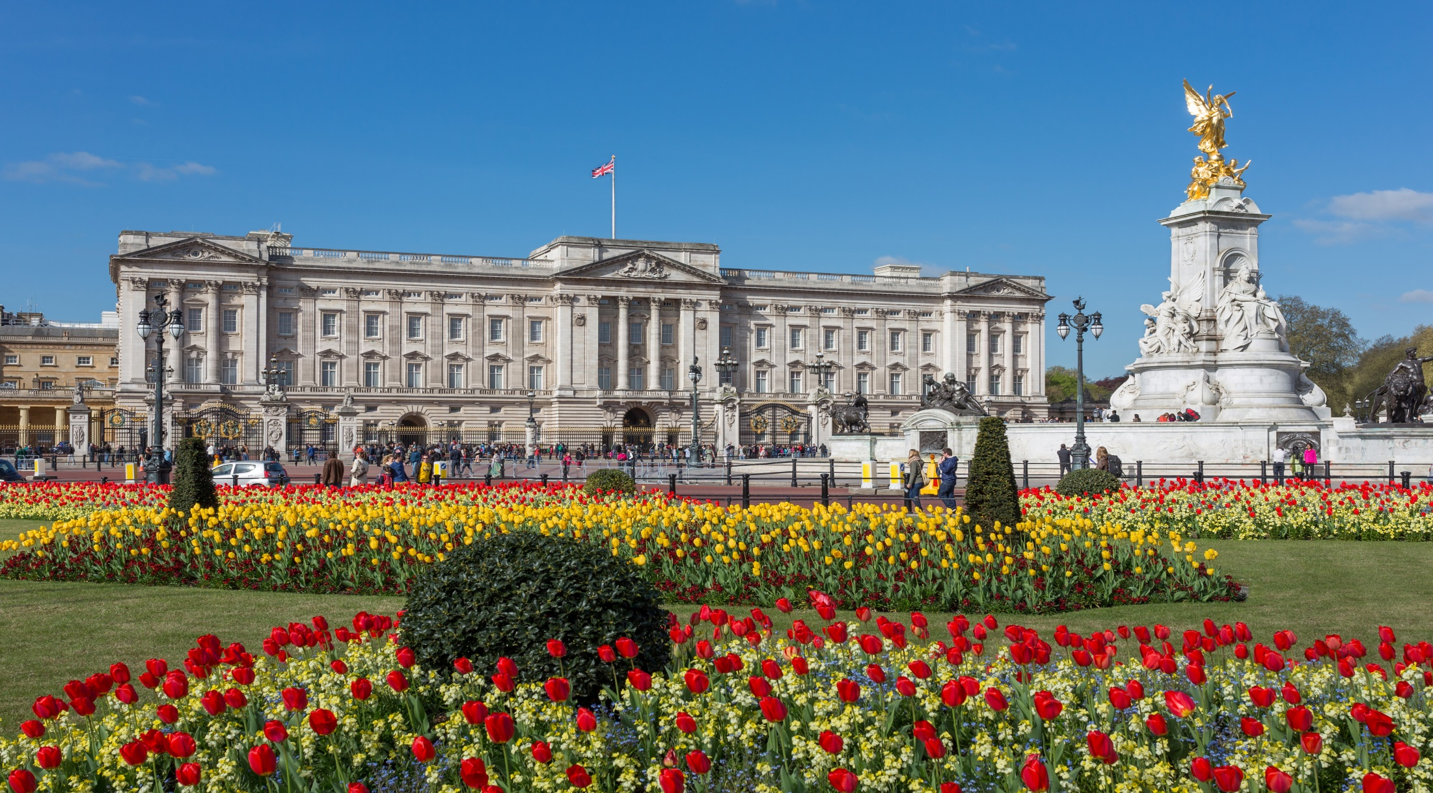
This is the Queen’s home. It is Buckingham Palace. If the Queen is in the palace, you can see her flag on the flagpole. If she is not there, you can see the Union Jack, the flag of the UK.

Slide 4
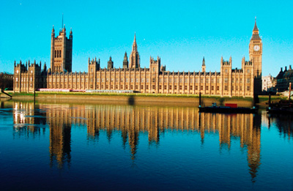
This beautiful building is the Houses of Parliament. British politicians work there.

Slide 5
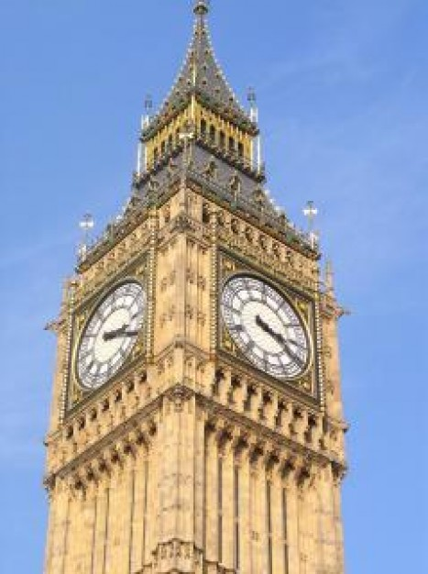
This clock tower is Big Ben. It is next to the Houses of Parliament. It is a symbol of London. Big Ben is actually a bell, not a clock.

Slide 6
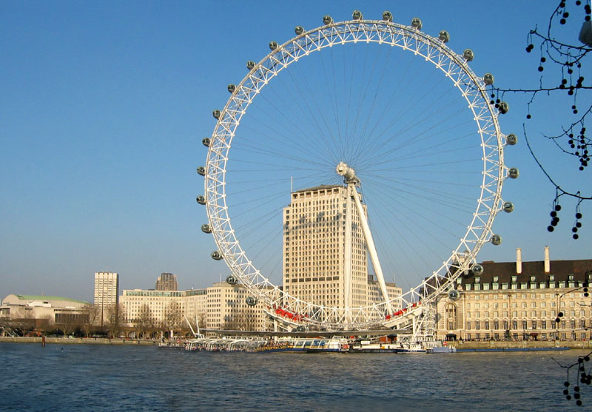
One of the highest sights of London is the London Eye. It is a big wheel from which you can see a lot of sights. It takes 30 minutes to go around.

Slide 7
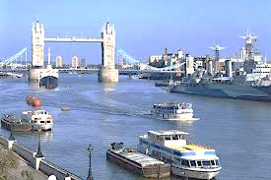
This is the River Thames, you can take a bout trip on it.

Slide 8
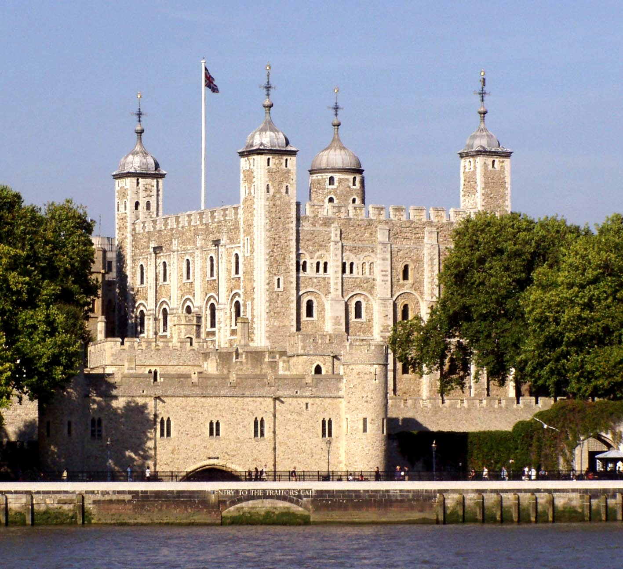
This is the Tower of London. It is the oldest building in London. Long time ago it used to be a king’s palace and a prison. You can see Crown Jewels there.

Slide 9
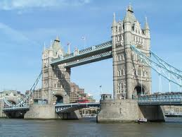
This is Tower Bridge. One of the decks opens so that ships can go under the bridge. It is near the Tower of London.

Slide 10
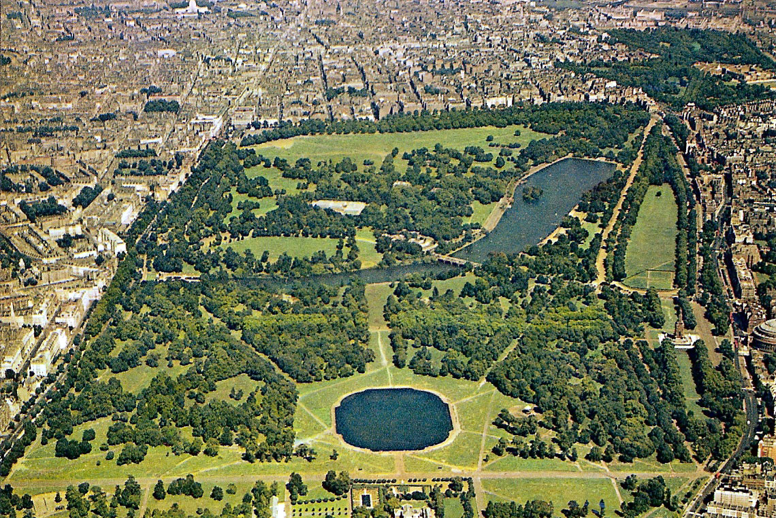
This is Hyde Park. It is beutifull. You can walk, ride a bike, relax, feed the birds, enjoy the nature there. You can even listen to a concert there.

Slide 11
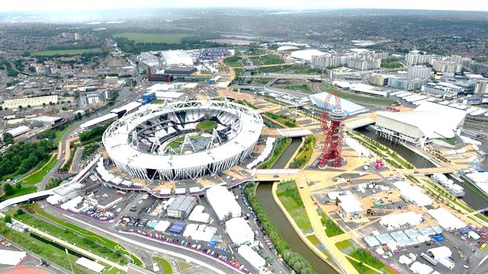
This is the Olympic park. It was built for the Olympics in 2012.

Slide 12
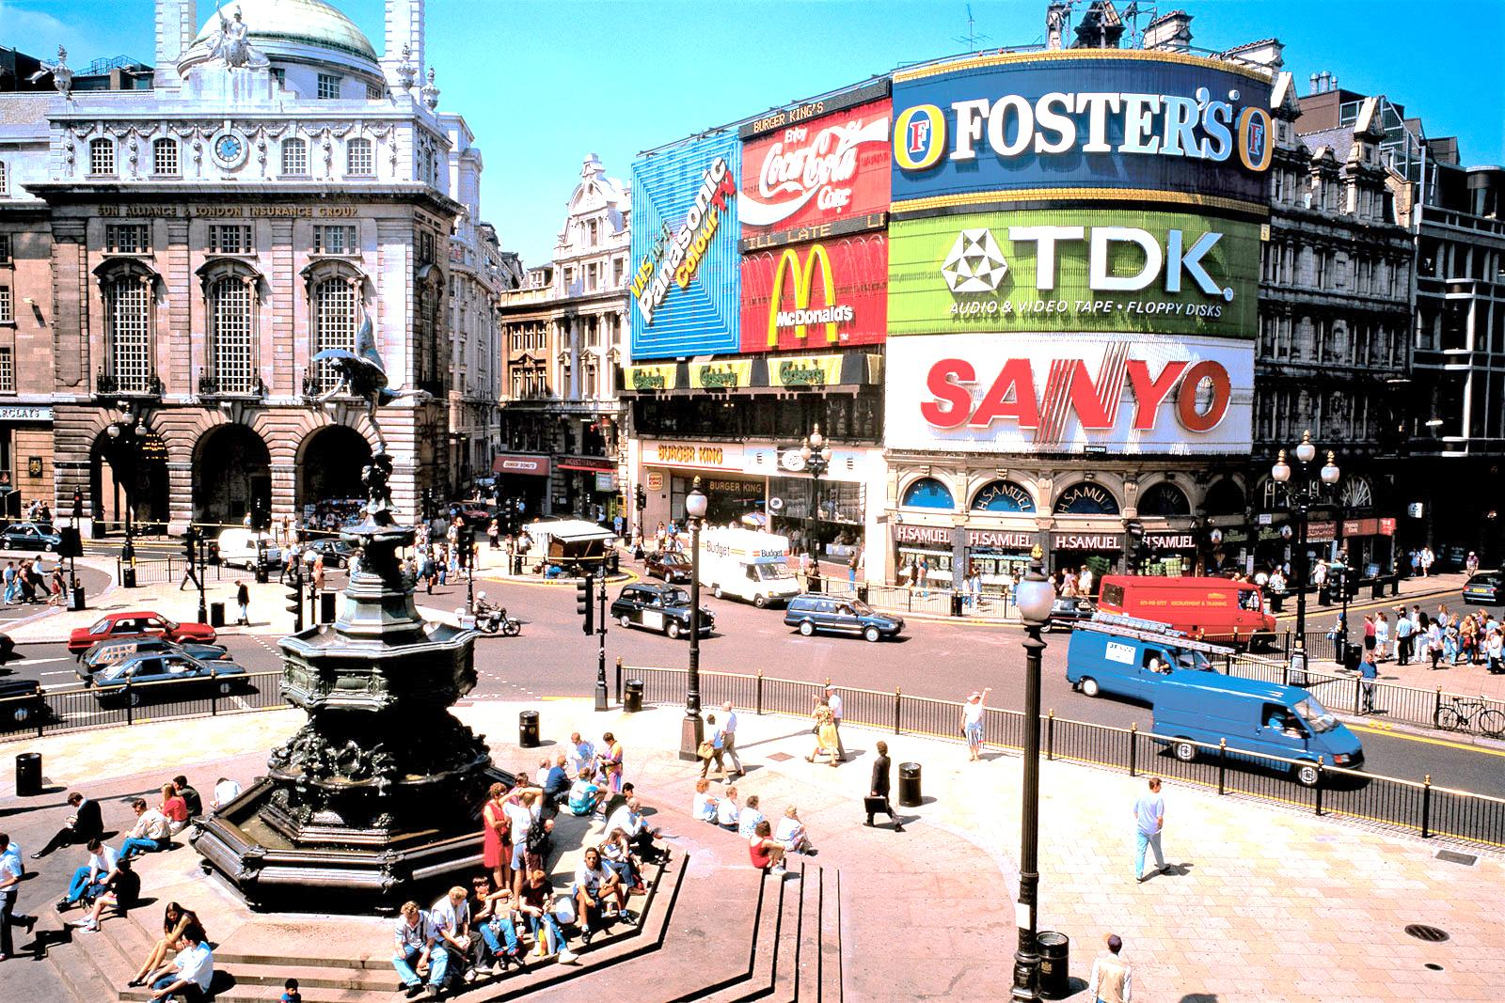
This is Piccadilly Circus, one of the famous sqares in London. A lot of people meet there.

Slide 13
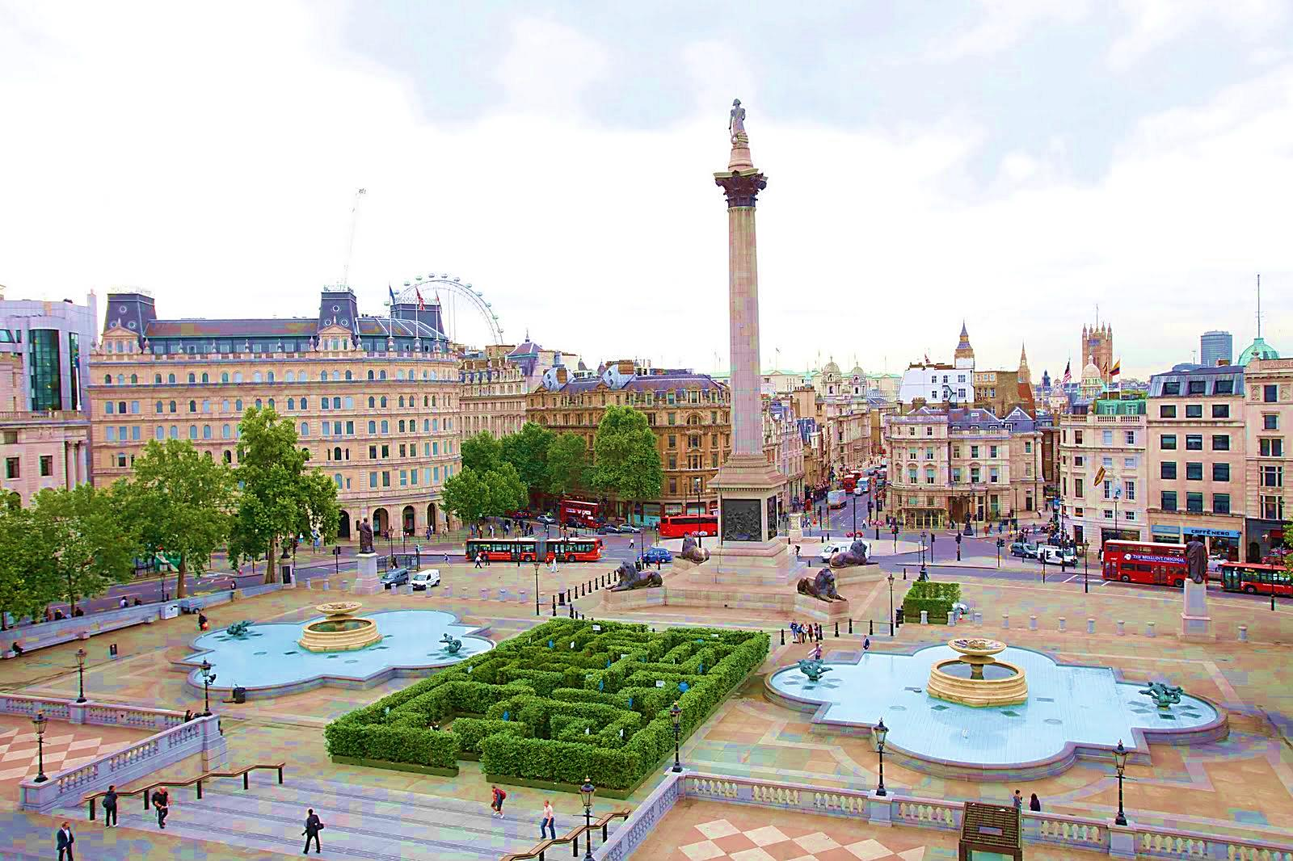
This is Trafalgar sqare. You can see many people there. You can also see Nelson’s Column, two fountines, statues of lions.

Slide 14
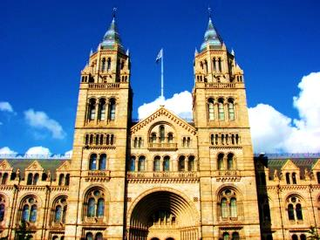
This is the Natural History Museum. In museum you can see dinosour’s bones, a lot of plants, animals, rocks, and other interesting things.. The best thing is that the entrance is free.

Slide 15
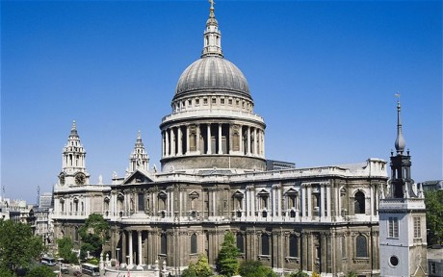
This is St Paul’s Cathedral. It is on a hill.

Slide 16
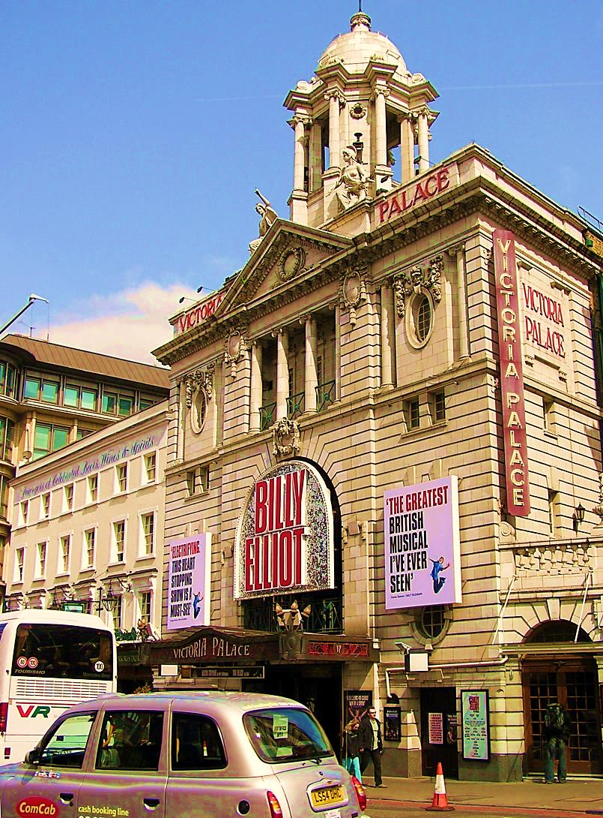
This is the Victoria Palace Theatre, one of the many theatres in London. You can watch a play there.

Slide 17
Done by: Jana Jovanović
Marta Kaluđerović
Iva Jerković

