Slide 1
Stone soup
Retell the story with the help of the pictures.

Slide 2
came to
knocked on
asked for some f - - d
didn’t want to give him any f - - d
had a magic s - - - e
asked for some w - - - r

Slide 3
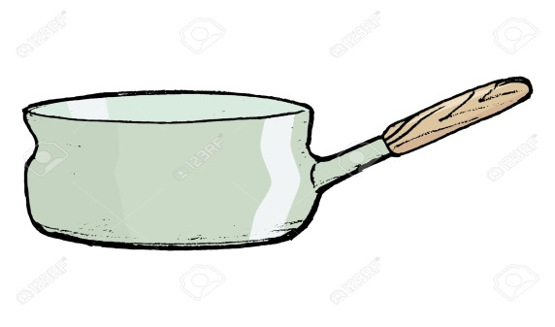
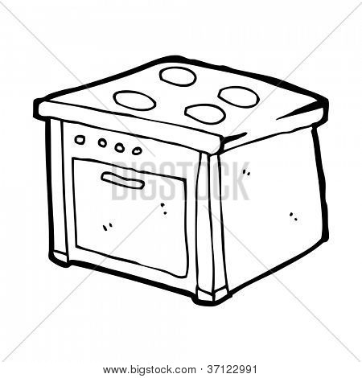
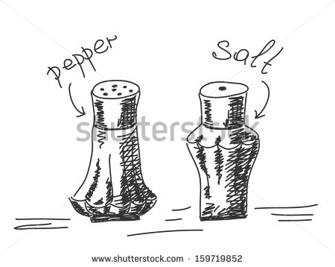
gave him some w - - - r
fetched a s - - - - - - n
put it on the c - - - - r
asked for some s - - -t
and p - - - - r

Slide 4

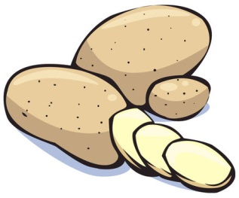

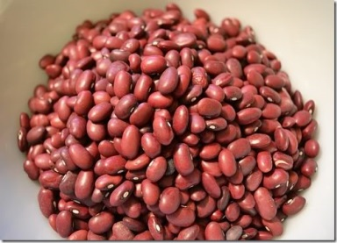
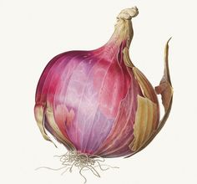
then ... asked for some
v - - - - - - - -s
ran into the garden and brought back some
p - - - - - - s,
c - - - - - s,
b - - - s and
a big o - - - n

Slide 5

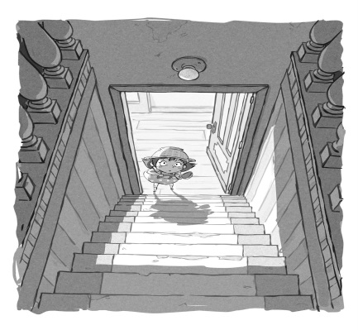


needed some m- - t to finish the soup
ran into the cellar
came back with some
h – m and
s - - - - - -s

Slide 6
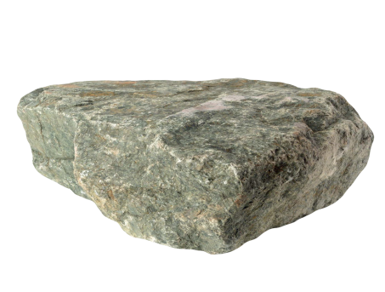


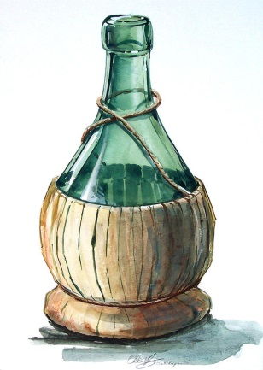
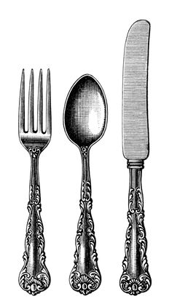
couldn’t see the s - - - e
so the soup …
went to the cupboard
and fetched
a loaf of b- - - d
b - - - - r
a bottle of w - - e
put some
f - - -s
s - - - - s and
k - - - - s

Slide 7
the soup was ...
because they shared f- - d
and helped each ...

