Slide 1
Holidays
Vocabulary

Slide 2
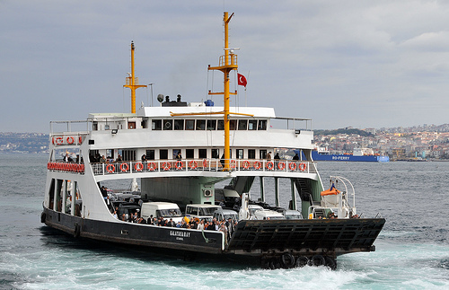
You can learn all about the environment.
The theme park has got a lot of exciting rides.
A lot of people go abroad for their summer holidays.
You can take the ferry to France.
environment /ɪnˈvaɪrənmənt/
the ​air, ​water, and ​land in or on which ​people, ​animals, and ​plants ​live
ride /raɪd/ a ​journey on a ​horse or ​bicycle, or in a ​vehicle
abroad /əˈbrɔːd/ in a foreign country
ferry /ˈferi/ a ​​ship for taking ​passengers and ​vehicles ​across an ​area of ​water

