Slide 1
Meerkats
Vocabulary

Slide 2

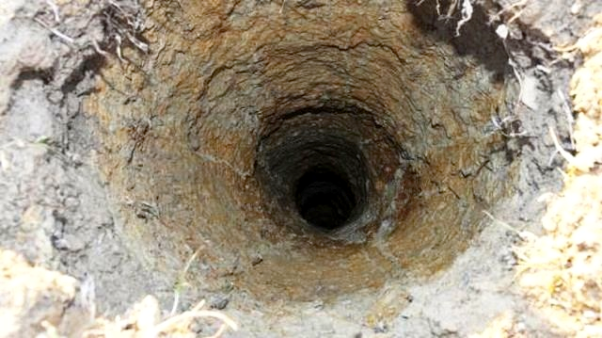
Meerkats are brown with black stripes and black ears.
They sleep in holes in the ground.
Meerkats leave their holes in the morning.
stripe /straɪp/ line
hole /hoʊl/ a place in the ground where animals live
leave /liːv/ go away

Slide 3
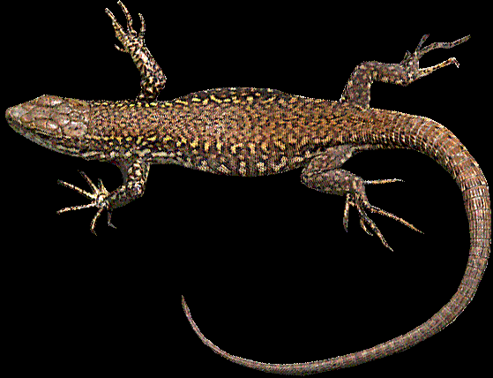
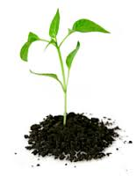
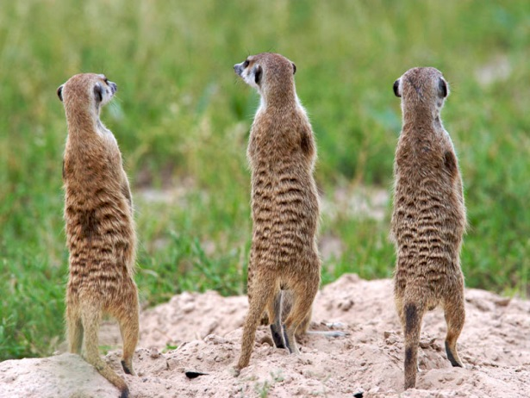
They eat plants, lizards and mice.
When meerkats eat, some of them stand on two legs and guard the others.
plant /plɑːnt/ it grows out of the ground
lizard /ˈlɪzəd/ a ​​reptile with a ​long ​body, four ​short ​legs and a ​long ​tail
guard /ɡɑːd/ look after, protect

Slide 4
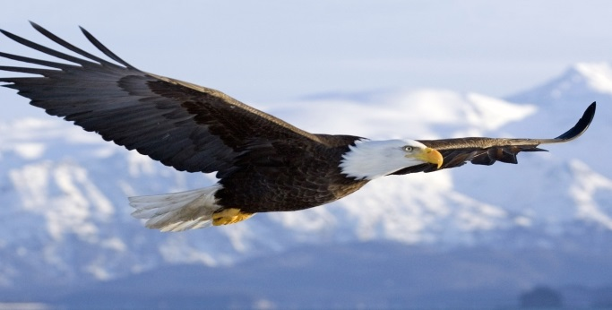
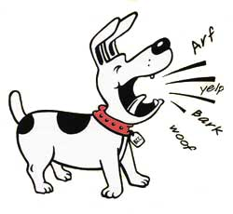
When the guards see an eagle, they bark.
eagle /ˈiːɡl̩/ a ​large, ​strong ​bird with a ​curved ​beak that ​eats ​meat and can ​see very well
bark /bɑːk/ the loud noise that a dog makes

