Slide 1
Different holidays in different religions
Made by: Petra Gudac and Lucija Glasnović, 8.a

Slide 2
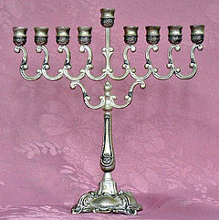
Jewish Hanukkah
- The name "Hanukkah" derives from the Hebrew verb "חנך", meaning "to dedicate". On Hanukkah, the Jews regained control of Jerusalem and rededicated the Temple
- it starts on the 25th day of Kislev according to the Hebrew calendar.
- it is an eight-day Jewish holiday
- it is also known as the Festival of Lights or Feast of Dedication.
- The festival is observed by the kindling of the lights of a unique candelabrum, the nine-branched Menorah or Hanukiah
-

Slide 3
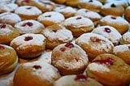
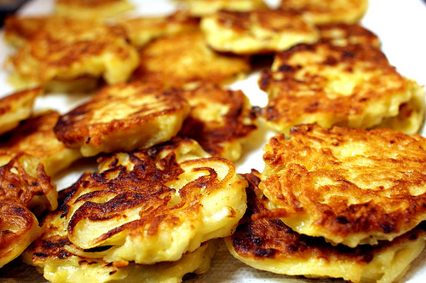
Hanukkah- food
Food:
- potato pancakes (lataks)
- douhnuts (sufganyot)
- they are traditional treats because they are cooked in oil and they remind us of the miracle of the holiday.
- cheese, cheesecake and blintzes weren’t popular until the Middle ages, but they emerged from the story of Judith (a great beauty who saved a village from the Babylonians

Slide 4
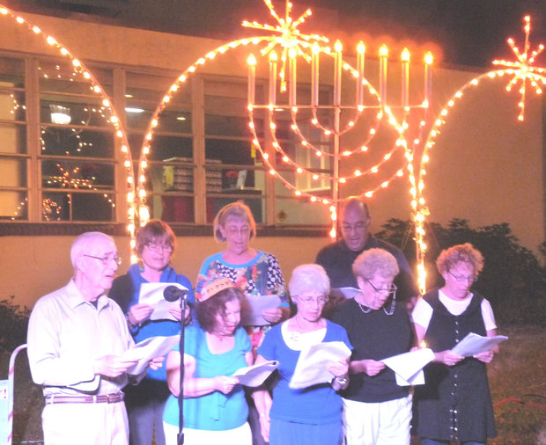
Hanukkah music
Here are some Hanukkah songs:
- Ocho Kandelikas
- Haneirot Halalu
- Mi yimalel
- Chanuka, Oh Chanukah!

Slide 5
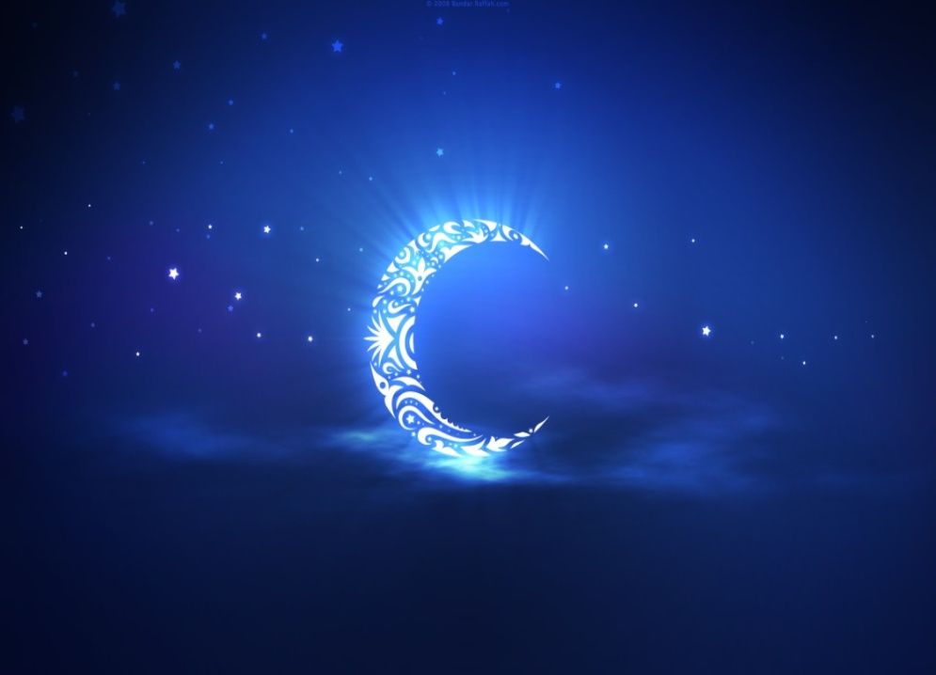
Muslim Ramadan
- the ninth month of the Islamic calendar.
- Muslims worldwide observe this as a month of fasting.
- The word Ramadan comes from the Arabic root ramiḍa or ar-ramaḍ, which means scorching heat or dryness.
- Fasting the month of Ramadan was made obligatory during the month of Sha'aban, in the second year after the Muslims migrated from Mecca to Medina.

Slide 6
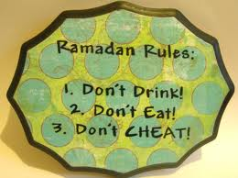
Ramadan rules
- involves fasting during the daytime, saying no to food, drink, smoking and sexual activities.
- he who fasts during Ramadan with faith and seeks his reward from Allah will have his past sins forgiven
- he who prays during the night in Ramadan with faith and seeks his reward from Allah will have his past sins forgiven
- and he who passes Lailat al Qadr in prayer with faith and seeks his reward from Allah will have his past sins forgiven.

Slide 7
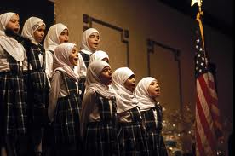
Ramadan songs
Here are some Ramadan songs:
- Ramadan
- Ramadan El Sana Di
- Nice song of Ramadan
- Noon Noon

Slide 8
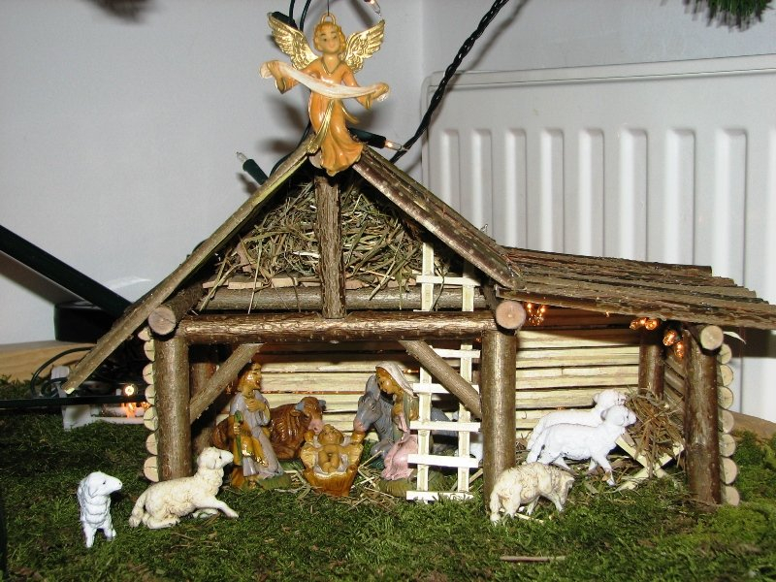
Christmas:)
- it is celebrated on the 25th December, every year.
- it marks the birth of Jesus Christ, the son of Holy God
- traditionally people decorate a pine tree in their houses and put crechers under it. They share gifts between family and friends.
- Christmas period begins on the First Sunday of Advent. There are 4 Sundays, and on each Sunday a Christian has to lit a candle.
- Chrismas period ends with the Holy Three Kings, on the 6th January

Slide 9
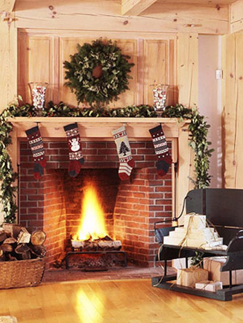
Christmas ‘rules’
- you should make a lots of cakes and all sorts of sweets.
- you should be happy and not fight with your family, friends
- you should go to the church and conffess your sins to the priest.
- on the Christmas Eve you should put a sock on the fireplace (a window if you don’t have one) and wait until the Christmas morning when your socks will be full with presents (not guaranteed that it will work every time)

Slide 10
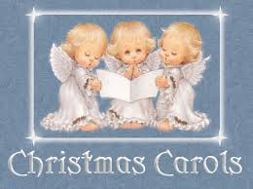
Christmas songs:
- Carol of the Bells
- Jingle bells
- Fa la la Christmas
- Let it Snow!

Slide 11
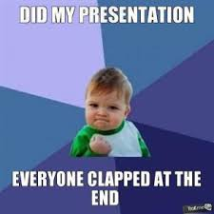
THE END
CLAP!!!

